Slide 1


POPULATION REGISTER FOR CITIZENS
POPULATION REGISTRATION SYSTEM

Slide 2







THE CONCEPT OF ELECTRONIC ADMINISTRATION
Citizens and
Legal entities
State Registers
E-GOVERNMENT
PORTAL
Information system of planning, monitoring and statistics
ELECTRONIC
PAYMENT SYSTEM
E-SERVICES
PORTAL
INFORMATION SYSTEMS OF STATE AGENCIES
NATIONAL VERIFICATION
CENTER
Public Service Centers

Slide 3








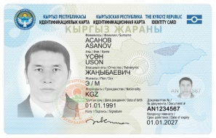


UNIFIED STATE REGISTRATION SERVICE IN THE LIFE OF THE CITIZEN
Registration of parents
Adoption
Address change
Marriage
Changes in the list
Change of nationality
Birth
Name change
Obtaining an ID-Passport
Divorce
Obtaining an international passport
Pensioner

Slide 4
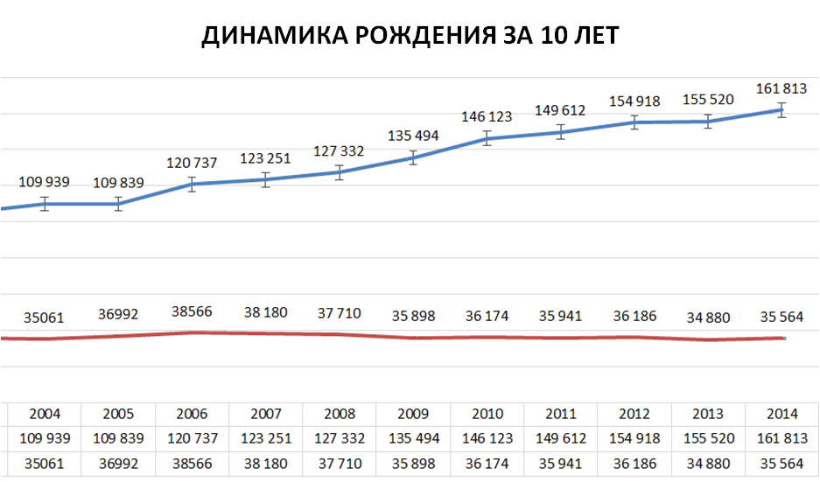


UNIFIED STATE REGISTRATION SERVICE FUNCTIONING MODEL
Списки избирателей
Dynamics of birth in 10 years
Database of passports
База данных ЗАГС
ПИН
Сведения ЗАГС
Адрес
Биометрич. данные
Фотография
Паспорт
Гражданин
Отпечатки
ПИН
Подпись
Address database
База БИО

Slide 5
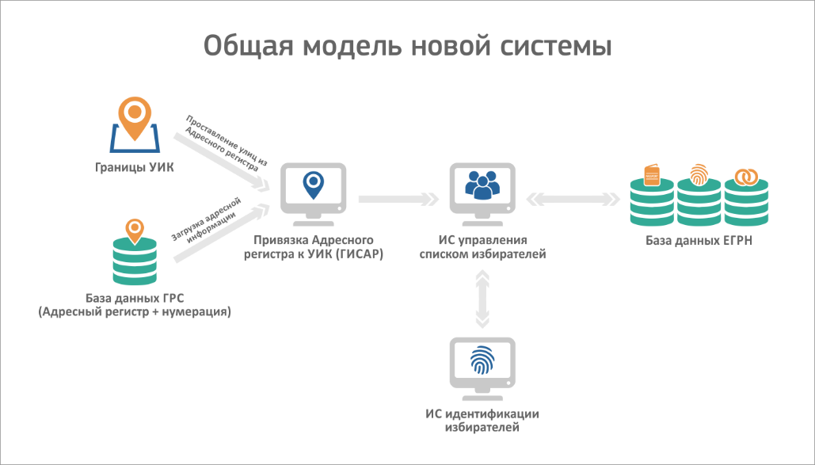
GENERAL MODEL OF THE NEW SYSYTEM
UIK (polling station) borders
Attach AR to UIK (GISAR)
IS administration list of voters
USRS DB
DB SRS (Address register + numbering
IS identification of voters

Slide 6
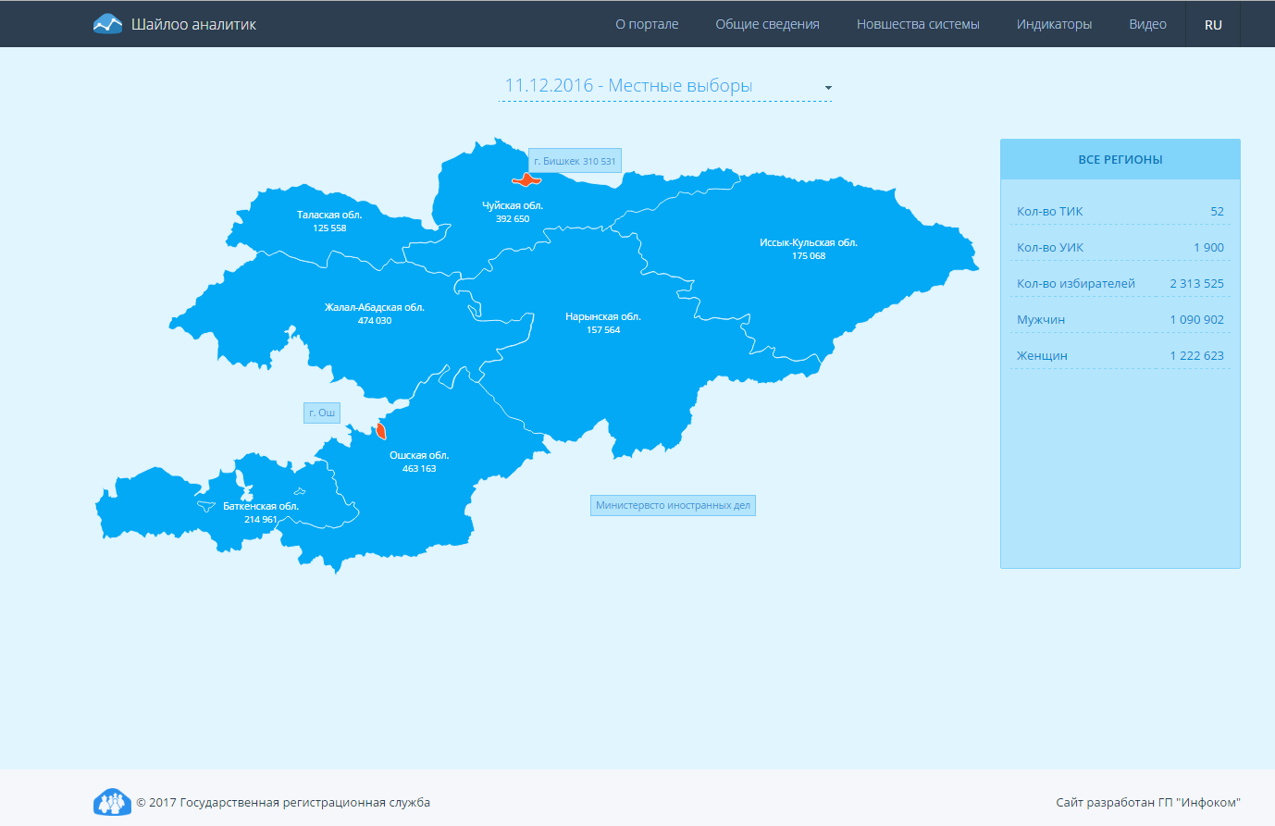

Slide 7
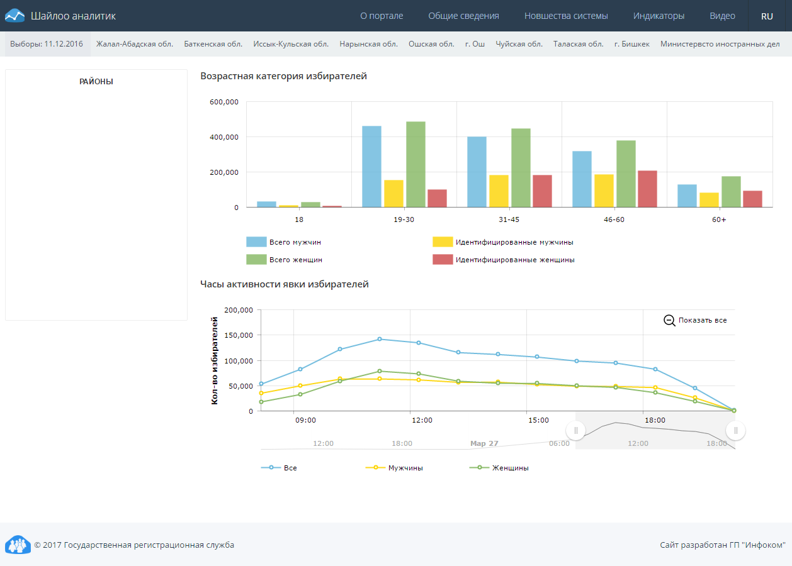
Regions
AGE CATEGORY OF THE VOTERS
Total men
Identified men
Total women
Identified women
Voters
All
Men
Women

Slide 8
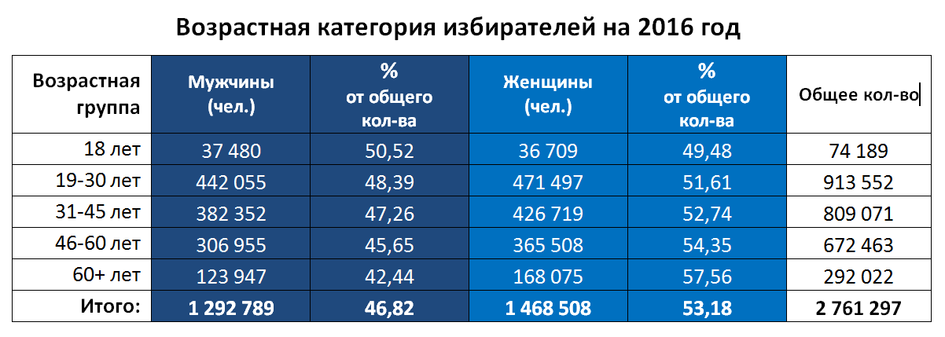
AGE CATEGORY OF THE VOTERS 2016
AGE
CATEGORY
MEN
%
of total
WOMEN
%
of total
TOTAL
18 Years
19-30 Years
31-45 Years
46-60 Years
60 + Years
Total:

Slide 9
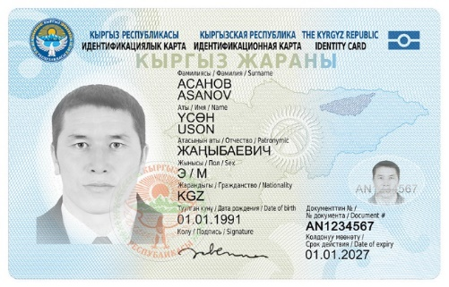
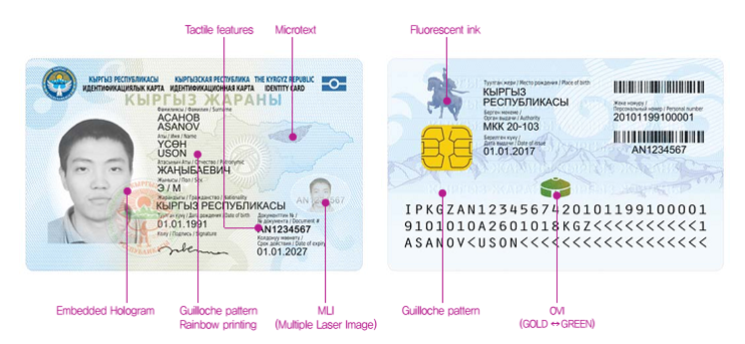
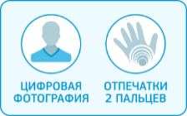
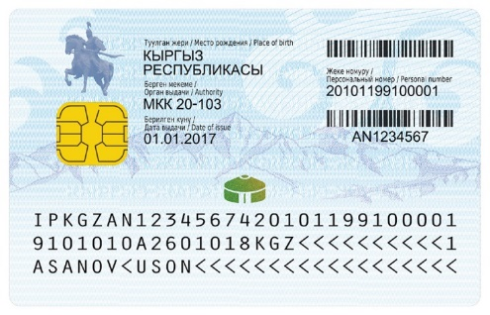
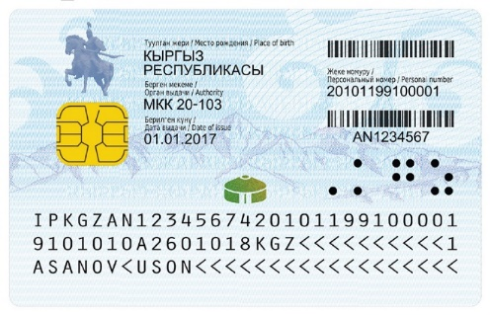
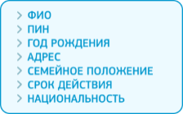


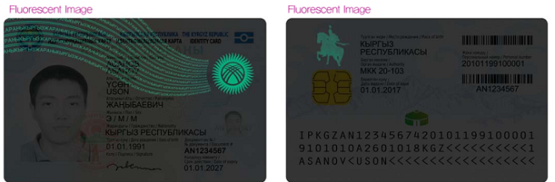

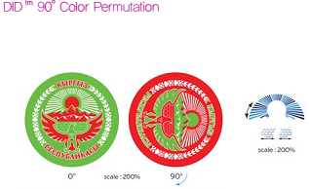
eID functions
NEW GENERATION PASSPORTS
Protective elements

Slide 10
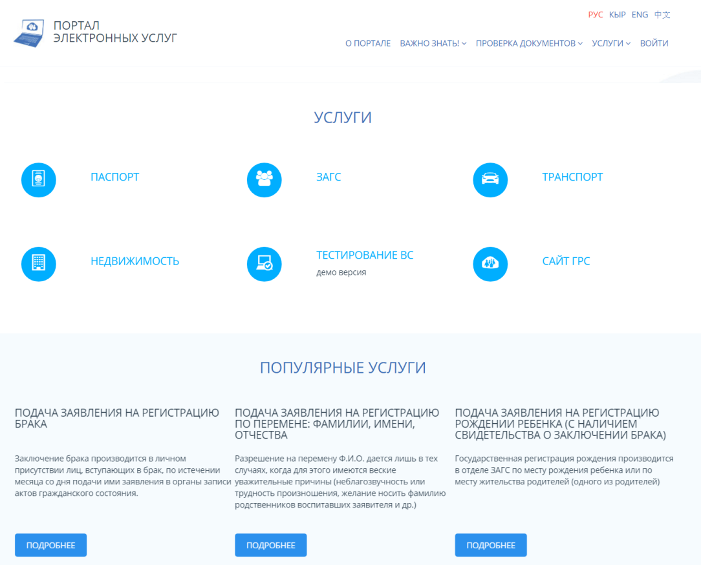
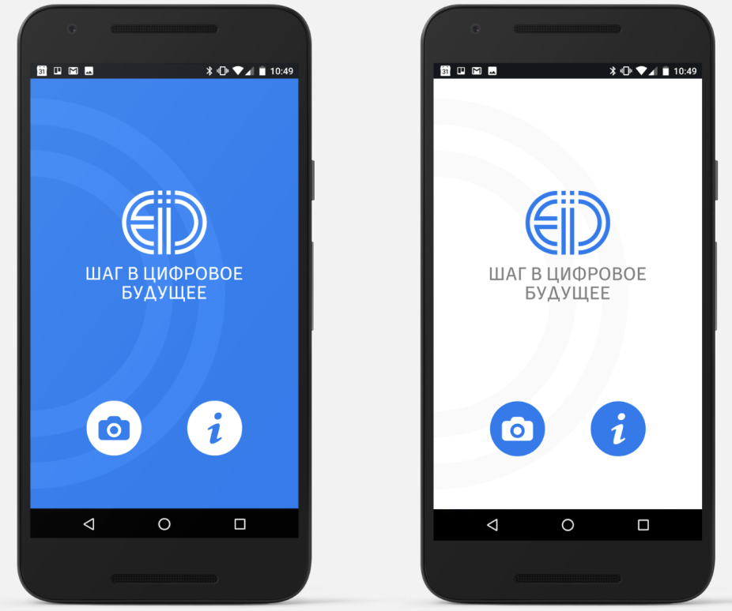
ELECTRONIC SERVICES FOR CITIZENS

Slide 11
THANK YOU FOR ATTENTION!
Web site www.grs.gov.kg

