Slide 1


Digitising Civil Registration and Vital Statistic
General Department of Identification (GDI)
Ministry of Interior
Kingdom of Cambodia

Slide 2
Outline
Current Status of CRVS in Cambodia
New development of CRVS & ID Management System
Preservation of store records
Operational Workflow
Future

Slide 3
Current Status of CRVS in Cambodia
CRVS system
(Paper Based)
Birth certificates are mandatory
for issuing Khmer ID
Khmer ID system
(Biometric based)
Nationality system
(Paper Based)
One way link to retrieve data from Khmer ID system but currently not being used
Passport system
(Biometric based)
Residential records
(Paper Based)
Most systems are still paper-based
Authentication services are not available online between the various systems

Slide 4
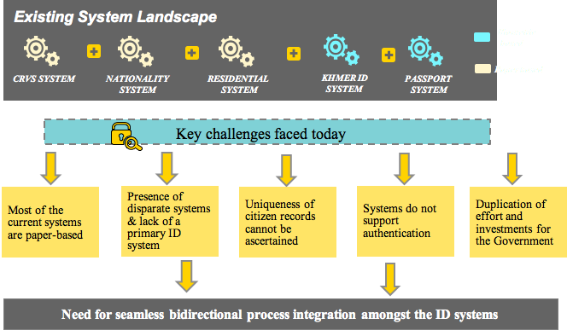
Current Status of CRVS in Cambodia

Slide 5
New development of CRVS & ID Management System
General Department of Identification established in 2014 (GDI)
National Strategic Plan of Identification approved by government in June 2016
Final draft of NSPI Implementation Plan (2017)
National Steering Committee on CRVS & ID Management (NSCI) established in May 2017, chair by DPM & Minister of Interior
  National Technical Program Implementation Team (TPIT), chaired by GDI
Government agreed on PPP approach to invest in ICT infrastructure and system.

Slide 6
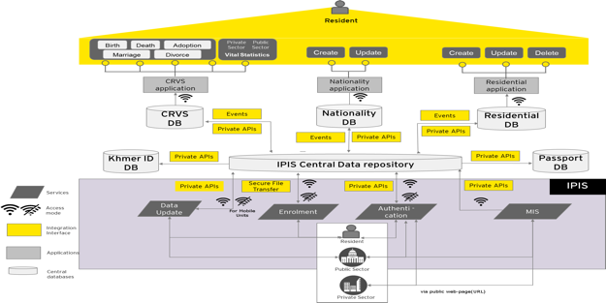
Conceptual design on integrated CRVS & ID Management System

Slide 7
Progress to date
Pilot digitizing CR system in 3 provinces
Centre of Civil Registration Data Management has currently digitalized approximately six million out of 16 million records.
Issuing e-ID card approximately ten million out of 16 million records. Merging and migrate data from e-ID card with six million digitalized records to CR database
Modernize existing CR system to web base system that can link with patient medical registration system (ministry of heath) and will be piloted in 2 provinces in December 2017

Slide 8
Preservation of store records
Electronic records
  Centralized database system at national level (MOI)
  Daily backup database
  Disaster Recovery site
Document management: scan all the necessary documents
Territories outside the electronic system
  Offline system to do registration and transfer to central system when there is Internet connection

Slide 9
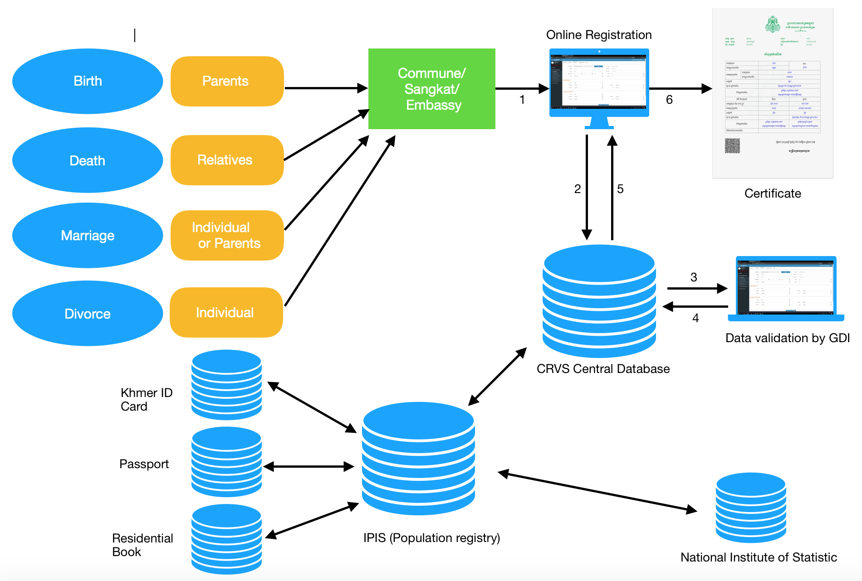
Operational Workflow

Slide 10
Thank you

