Slide 1

Evaluation of the Quality of Civil Registration and Vital Statistics System: The Philippine Setting 15 November 2017 Hanoi, Vietnam
Republic of the Philippines
PHILIPPINE STATISTICS AUTHORITY
Presented by:
Editha R. Orcilla
Assistant National Statistician
Civil Registration Service

Slide 2
The evaluation of the quality of civil registration and
vital statistics system
1
National Assessment
2
Sub-national Assessment
3
Strategic Plans (five years)
4
CRVS Decade
5
Enterprise Architecture
6
National Workshop on Civil Registration (NWCR) and CRVS Seminars

Slide 3
The evaluation of the quality of civil registration and
vital statistics system
7
PSDP Chapter on CRVS
8
CRS database cleaning
9
Data Quality Assessment

Slide 4

ADMINISTRATIVE ARRANGEMENT OF CRVS
Republic of the Philippines
PHILIPPINE STATISTICS AUTHORITY
Office of the Head of the Local Government Unit
Local Civil Registrar Offices
Civil Registrar General (National Statistician)
Deputy National Statistician
PSA Regional Statistical Service Offices
PSA-Provincial Statistical Offices
Civil Registration Services
Health Sector
Barangays
Civil Register Management Division
(documents)
Churches
Vital Statistics Division
(data files)

Slide 5
Civil Registration and Vital Statistics Process Flow
Republic of the Philippines
PHILIPPINE STATISTICS AUTHORITY
Health Officer
Death/Fetal death
Death/Fetal death
(Within 48 hours)
(Within 30 days)
Registrant/ Informant/ Attendant/
Solemnizing officer
PSA-CO
6th week after ref. month
Birth/Marriage
(Within 30 days)
PSA-PO
Civil Registrar
10 days after reference month

Slide 6

National
Assessment

Slide 7
WHO Assessment Framework
Developed by the World Health Organization (WHO) and University of Queensland (UQ) that allows countries to comprehensively evaluate their civil registration and vital statistics system.

Slide 8
Components
National Legal Framework for Civil Registration
and Vital Statistics (CRVS)
2. Registration practices, Coverage and
Completeness of Registration
3. Forms and Data Quality
4. Data Storage, Tabulation, Access, and
Dissemination
5. ICD 10
WHO Assessment Framework

Slide 9
KEY RECOMMENDATIONS
National Legal Framework on CRVS
Increased lobbying for approval of pending proposed bills on civil registration.
Building up a campaign to lobby for increased budget on civil registration at the Local Government Unit (LGU) levels
Strengthening the Administrative Order and Rules for civil registration units at the LGU level, elevating the importance and appreciation of civil registration
Compliance with the local government code of 1991 on creation of civil registration office and permanent civil registrar.

Slide 10
KEY RECOMMENDATIONS
National Legal Framework on CRVS
5. Strengthen the vital registration network and
establish partnerships among civil registration
stakeholders, e.g. NSO, health agencies, universities
and local civil registrars;
6. Sign a Memorandum of Agreement to work together
to improve the vital registration system in the country;
7. Develop a comprehensive civil registration strategic
plan that focus on the gaps and issues identified in the
Civil Registration and Vital Statistics System
assessment, and which would include investment
plans, resource requirements and timelines.

Slide 11
KEY RECOMMENDATIONS
Registration practices, Coverage and Completeness of Registration
Orientation/training of medical/health officers, hospital administrators and other stakeholders on civil registration and vital statistics
Establishing vital registration protocols, guidelines, and procedures for each sector including private and public hospitals, Municipal Health Offices and other institutions.
Information campaign on registration focused on marginalised populations (e.g. Muslim population, Indigenous Cultural Communities, Indigenous Peoples and Children In Need of Special Protection) and poorer provinces.

Slide 12
KEY RECOMMENDATIONS
Registration practices, Coverage and Completeness of Registration
Lobbying for free registration of timely registered documents
Study on the level of registration by province
Study on the level of registration by sector (depressed areas, marginalized populations)

Slide 13
KEY RECOMMENDATIONS
Forms and Data Quality
Assessment of data quality using hospital records and the National Statistics Office’s Decentralized Vital Statistics System database
Developing methodology/study to check data quality and pertinent adjustment techniques for Philippine cause-of-death data
Conducting a study on the patterns of cause-specific mortality (diseases to be identified by a technical working group)
Developing a mechanism to keep medically and lay reported data separated to improve the quality of data

Slide 14
KEY RECOMMENDATIONS
Data Storage, Tabulation, Access, and Dissemination
Making presentations to the Mayors of LGUs to clearly define functions of a Local Civil Registrar Office with regards to timeliness and completeness of submission of civil registry documents.
NSO to study ways to improve the timeliness of the Vital Statistics Report.
Intensive promotion of the electronic Civil Registration Information System (CRIS) to LGUs, hospitals and other related institutions.

Slide 15
KEY RECOMMENDATIONS
Data Storage, Tabulation, Access, and Dissemination
Tabulating statistics on specific place of occurrence of the vital event (hospitals, health institutions, home, etc.) and expand the number of age groups.
Motivating LGUs in cities to purchase computers using their own resources and other municipalities to develop resource mobilization schemes for obtaining computers in order to facilitate data storage and transmission to National Statistics Office (NSO).
Continuous training to LGU staff in civil registration procedures and use of electronic systems.

Slide 16
KEY RECOMMENDATIONS
ICD 10
Training on ICD-10 and related topics (e.g. verbal autopsy, completion of Death Certificate Form) for staff of the Ministry of Health, Local Civil Registration Officers, Medical Records Officers, Provincial Statistical Office staff
Inclusion of ICD-10 in medical and paramedical curricula.
Conducting evaluation of the quality of ICD 10 coding.

Slide 17
KEY RECOMMENDATIONS
ICD 10
Developing a guidebook and quick reference guide on certification of cause of death for doctors.
Conducting an evaluation of the quality of medical certification on death certificates.
Conducting a nationwide launch of the new Death Certificate Form.

Slide 18

Subnational
Assessment

Slide 19
Subnational Assessment
The Assessment of the Civil Registration System and Conduct of Completeness Study of Death Registration Project
The project has two components namely: assessment of the civil registration system at the sub-national level and conduct of completeness study of death registration in the country.

Slide 20
Subnational Assessment
Component 1: The Assessment of the Civil Registration System
To assess the civil registration system in the country at the sub-national level, the Technical Working Group (TWG) composed of representatives from the NSO, Department of Health, National Statistical Coordination Board and University of the Philippines-Population Institute selected 7 sample provinces (Rizal, Cebu, Palawan, Ilocos Norte, Leyte, Davao del Sur, and Cotabato)
Using the UQ-WHO Vital Registration Framework, the major findings of the study identified the barriers of birth and death registration and concerns on data quality and data storage

Slide 21
Subnational Assessment
Component 2: Completeness Study of Death Registration in the Country
The study aims to determine the current under-registration of deaths by estimating the extent of completeness using the 2007 census data.
The results of the study showed that around 70 percent of all deaths that had occurred in the country during the year 2007 had been registered
The proportion of males whose death was registered in 2007 (72 %) is higher than the corresponding proportion of females (67 %).

Slide 22

Strategic
Plans
(CRVS)

Slide 23
Strategic Plans
In line with the key recommendations during the National Assessment of CRVS, the then National Statistics Office (NSO) and the Department of Health prepared the CRVS Strategic Plans for CRVS.
Vision
Mission
5-year Strategic Plans
Participants: Major Stakeholders of CRVS

Slide 24

CRVS
Decade

Slide 25
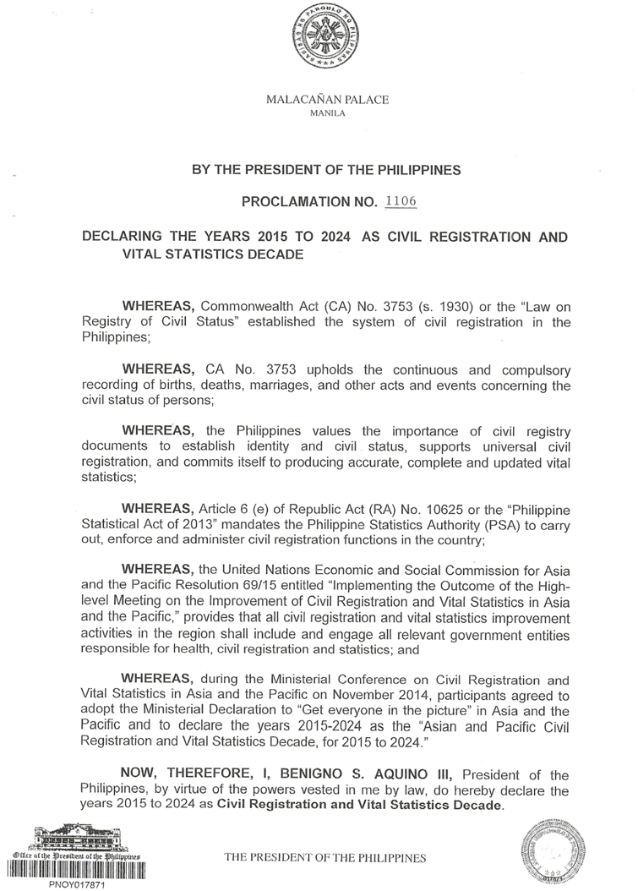
Programs and Projects on CRVS
CRVS Decade Activities
Presidential Proclamation No. 1106-2015 signed by His Excellency Benigno S. Aquino on 20 August 2015 “Declaring the Years 2015-2024 as Civil Registration and Vital Statistics Decade”
CRVS Decade Work Plan for 2015-2024 drafted and included in the Philippine Statistical Development Plan Transitional Update Plan (2016-2017)
National Targets (preliminary) set in the IAC CRVS Orientation workshop and commitments of CRVS stakeholders identified

Slide 26

Enterprise Architecture

Slide 27
Enterprise Architecture
Enterprise Architecture (EA) is one of the interventions of the Data for Health (D4H) project implemented by the Union of North America together with the Philippine Statistics Authority (PSA) and the Department of Health (DOH) in the Philippines. D4H seeks to support at least 20 countries, the Philippines included, improve their collection and use of crucial public health information through three components, namely: a) civil registration and vital statistics (CRVS); b) strategic use of data for policy and planning; and c) availability of information on non-communicable disease risk factors

Slide 28
Enterprise Architecture
Workshop on Enterprise Architecture
25-26 January 2016

Slide 29
Enterprise Architecture
WORKSHOP DESIGN
The Workshop on Enterprise Architecture aimed to strengthen capabilities to analyse the functioning of CRVS systems and find effective pathways for improving the efficiencies and quality of the vital statistics. Specifically, at the end of the workshop, the participants are expected to:
Understand the need for system thinking and have a much better understanding of the entire CRVS systems and not only the sub-system they are associated with
Be able to produce flow maps of three types of descriptive processes which will help understand problems with 1) organizational designs, including social network analysis; 2) CRVS processes, standards and integration ; and 3) CRVS performance.
Be able to interpret the flow maps and suggest improved ways on how CRVS processes and CRVS information technologies can work together to deliver systems performance and products.

Slide 30
Enterprise Architecture
The maps cover all sub-processes beginning with the declaration of the event (birth or death) until the statistics from these events are disseminated. These sub-processes include:
Civil Registration
Declare vital event (include notify and record vital event)
Validate vital event data
Register vital event
Certify vital event
Generate vital event statistical data
Store and Archive vital event data
Vital Statistics
Compile vital event statistical data
Quality control vital event statistical data
Generate vital event statistical data
Disseminate vital event statistical data

Slide 31

Conduct of NWCR

Slide 32
National Workshop on Civil Registration (NWCR)
Continuous capacity building of CRVS Stakeholders
PSA is now on its 9th series of the biennial National Workshop on Civil Registration (NWCR) in 2015 while the National Convention of Solemnizing Officers (NCSO) is on its 10th series by 2016.
The NWCR and NCSO aims to provide a venue for civil registrars, solemnizing officers, and other civil registration stakeholders to discuss issues and concerns on civil registration, share their best practices and experiences, and update them regarding new laws, policies, and rules on regulations on civil registration and vital statistics.
Notes:
PSA continues to enhance capability and coordination with the Local Civil Registrars through conventions and local seminars and trainings. Alternately, the PSA conducts the National Workshop on Civil Registration (NWCR) for local civil registrars and the National Convention for Solemnizing Officers (NCSO) for solemnizing officers with the aim to provide updates on civil registration.

Slide 33

Philippines
Statistical
Development
Plans (PSDP)
Chapter on
CRVS

Slide 34
Chapters of the PSDP 2018-2023
Major Sections of the PSDP 2018-2023
Clusters/ Chapters
PSS-Wide Concerns Chapter 1 – Management and Coordination of the PSS Chapter 2 – Statistical capacity development Human Resource development Statistical Research and development Chapter 3 – Statistical information management and dissemination Chapter 4 – International Cooperation
Demographic and Social Statistics Chapter 5 – Population and housing statistics Chapter 6 – Civil registration and vital statistics Chapter 7 – Labor and employment statistics Chapter 8 – Education and culture statistics Chapter 9 – Health and nutrition statistics Chapter 10 – Social protection statistics Chapter 11 – Security, justice and peace statistics Chapter 12 – Governance statistics
new

Slide 35
II. Scope and Coverage
Chapters of the PSDP 2018-2023
CLUSTER 2 – DEMOGRAPHIC AND SOCIAL STATISTICS
Chapter 6 - Civil registration and vital statistics
Concerned IACs: IAC on Civil Registration and Vital Statistics IAC on Population and Housing Statistics
Scope and Coverage: • Civil registration systems, documents, guidelines and processes • Births, deaths, and marriages Targets/Indicators

Slide 36
In summary
PSDP Plans/Targets/indicator
Philippines CRVS Decade Strategic Plans and Targets
PSA Strategic Plans/Goals/Thrusts (2 Goals and 12 Strategic Thrusts)
PSA Civil Registration Service Work Programs & Targets

Slide 37

CRS database cleaning

Slide 38
BRENLinking
Process of linking records of an individual in the Civil Registry System Database
Notes:
Request for copy issuance of birth, marriage or death resulting to records which are blurred and/or have unreadable entries in the PSA CRS database were issued feedback by PSA. Likewise, it the record being requested is not available in the CRS database, a negative certification is issued.

Slide 39
Production Vital Event Maintenance
Another way of cleansing the Civil Registry System database which involves the correction of the index of a record in the CRS database to ensure that a correct copy of the document is issued to the document owner
Notes:
Request for copy issuance of birth, marriage or death resulting to records which are blurred and/or have unreadable entries in the PSA CRS database were issued feedback by PSA. Likewise, it the record being requested is not available in the CRS database, a negative certification is issued.

Slide 40
Deduping of birth records
Cleansing of the Civil Registry System database
Automated matching of multiple records of an individual
Notes:
Request for copy issuance of birth, marriage or death resulting to records which are blurred and/or have unreadable entries in the PSA CRS database were issued feedback by PSA. Likewise, it the record being requested is not available in the CRS database, a negative certification is issued.

Slide 41
DATA QUALITY ASSESSMENT

Slide 42

Manual Assessment

Slide 43

100% checking on causes of death

Slide 44
Data quality is being evaluated under the following:
a. Data accuracy
-IRIS
-ANACONDA
- RA 9048/ RA 10172
b. Data access and availability
- Vital Statistics Reports/Special Releases/Vital
Statistics Tables/PUFs
c. Timeliness of data
-DVSS2K/DVSS211/PhilCris

Slide 45


CRS
www.psa.gov.ph

