Slide 1


Data Quality Assessments in Asia and the Pacific
Bloomberg Data for Health Initiative
Ashley Frederes Martin Bratschi
Senior Program Officer Deputy Director
Vital Strategies Vital Strategies

Slide 2
Data for Health Initiative
D4H focus:
  Quality of cause of death (COD) data
  Completeness of vital event (VE) registration at national and subnational levels
Data quality assessment methodologies and tools:
  VSPI score
  ANACONDA
  Completeness of vital event registration estimation
  Medical certificate of cause of death assessment tool
  Quality of ICD coding assessment tool

Slide 3
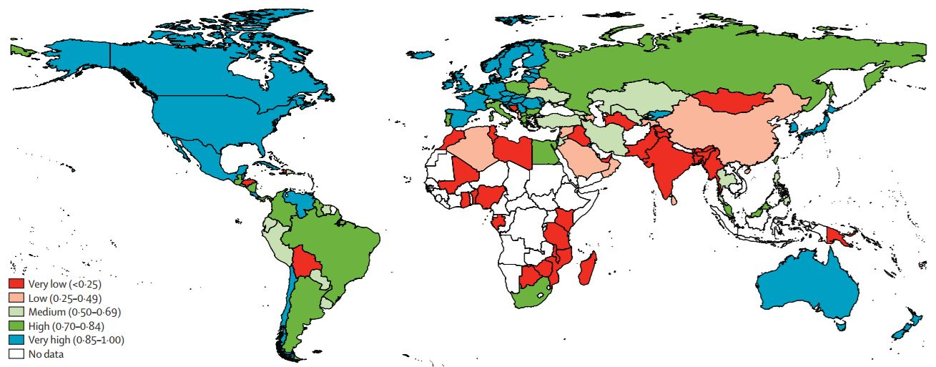
Vital Statistics Performance Index
‘The VSPI assesses CRVS performance through use of mortality data as a proxy for the quality and utility of all of the vital statistics produced by the civil registration system’*
*Source: The Lancet 2015
Notes:
So far, CRVS performance has been assessed by three broad approaches: expert reviews, country self-assessments, and external assessment of CRVS output. Each approach has advantages and limitations. Although these methods enable country stakeholders to jointly assess the entire CRVS system (inputs, processes, and output) the self-assessment approach used means that some subjectivity is unavoidable. Most attempts to assess CRVS systems globally have focused on one aspect of the system, such as birth registration coverage or coverage and quality of cause-of-death certification
A major limitation of sources of CRVS performance is that none can effectively and reliably be used to monitor global progress with CRVS systems development. To critically appraise development, quality, and policy utility of CRVS systems, we apply a new composite indicator that objectively assesses system performance on the basis of mortality data generated from CRVS systems worldwide.

Slide 4

Vital Statistics Performance Index
Six components:
  Completeness of death reporting
  Quality of death reporting
  Level of cause-specific detail
  Internal consistency
  Quality of age and sex reporting
  Data availability or timeliness
Computed on a continuous scale from 0 to 1 for each calendar year of vital statistics data since 1980
Value of 1 or close to 1 indicates the data accurately represent the epidemiological profile of the population
Value of less than 0.5 indicates that data are unreliable for policy and decision-making
Notes:
The VSPI metric comprises six components: completeness of death reporting, quality of death reporting, level of cause-specific detail, internal consistency, quality of age and sex reporting, and data availability or timeliness, each of which captures a different aspect of data accuracy or utility. A key characteristic of the utility of all CRVS systems is the extent to which they cover the entire population and register all births and deaths. The completeness estimate of the VSPI is generated by a combination of adult and child mortality estimates and the registered numbers of deaths. A frequently used measure of quality of cause of death reporting is the proportion of ill-defined deaths.
The VSPI was computed on a continuous scale from zero to one for each calendar year of vital statistics data that have been reported since 1980 and are publicly available for a country. A value of one or close to one signifies that the data for that country in that year (country-year records) accurately represent the epidemiological profile of the population from which they are generated, and are fit for policy use, whereas a value of zero indicates that data are unrepresentative of the epidemiological profile in that population and thus are of little or no use for policy

Slide 5

ANACONDA
Uses a reliable software technology Java(FX)
Accepts input data in Excel format
Ability to analyse national and subnational datasets
All core resources are contained in the tool

Slide 6
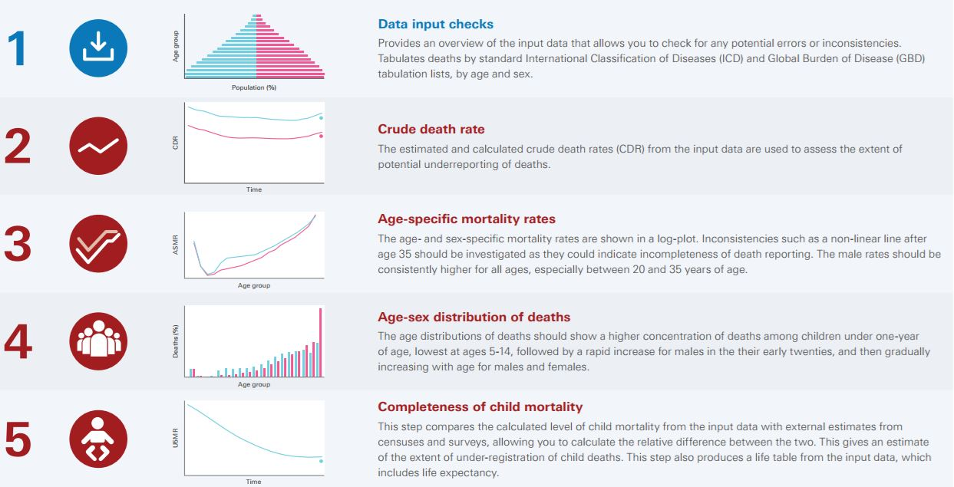
ANACONDA
Notes:
Step 1: data quality checks for males and females and age groups, as there are different mortality risks based on biological risk factors and social roles; assesses population distribution for obvious errors, such as a highly irregular age-composition with >50% of the population in a specific age group, such as children less than 5 years
Step 2: calculates CDR for males and females and compares them with GBD estimates of country-specific rates, producing a chart with time-trend comparators and CDR reference points for males and females calculated from country data
Step 3: Age and sex-specific mortality rates to assess plausibility
Step 4: Assess plausibility of age-sex distribution of deaths in country reported data, this will be determined by the age-sex patterns of mortality risks in a population as well as the population alive at different ages
Step 5: Compares the 5q0 (or the probability of a child dying before age 5) as calculated by the country’s input data with the estimated levels of 5q0 from the Inter-Agency Group for Child Mortality Estimation

Slide 7
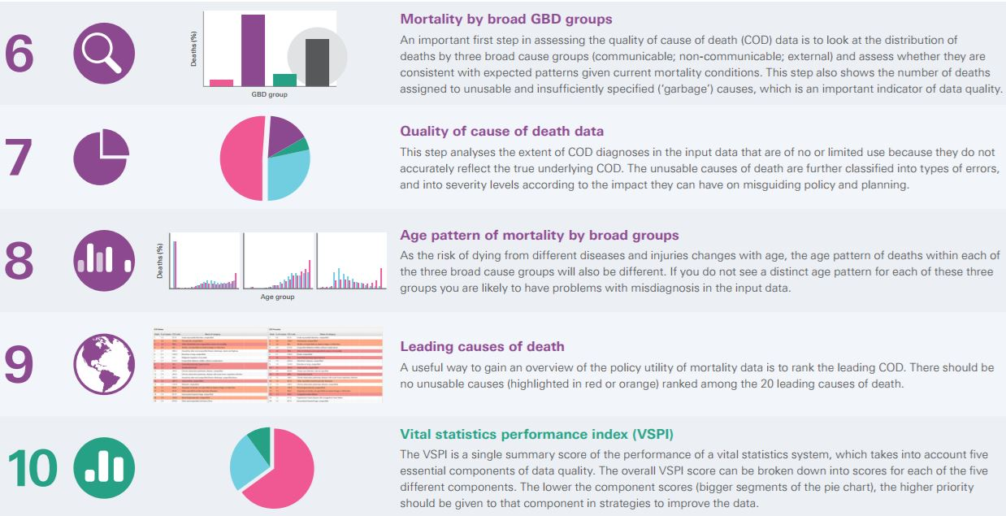
ANACONDA
Notes:
Step 6: a quality assessment of COD data to look at distribution of deaths by the 3 broad GBD groups (1. Communicable disease, 2. NCDs, 3. External causes) to assess whether the observed pattern is consistent with what is known about the epidemiological profile of the country, and to check that deaths due to external causes are not underreported (typically should account for 5-10% of all deaths)
Step 7: Assesses the proportion of deaths that are vague, ill-defined, impossible/unlikely based on the classification developed by the GBD group at IHME in Seattle
Step 8: Assesses the age and sex pattern for each GBD group for plausibility
Step 9: Produces the leading COD for males and females based on country input data and compares against GBD data on leading COD for the same population
Step 10: automatically calculates the VSPI score the country

Slide 8
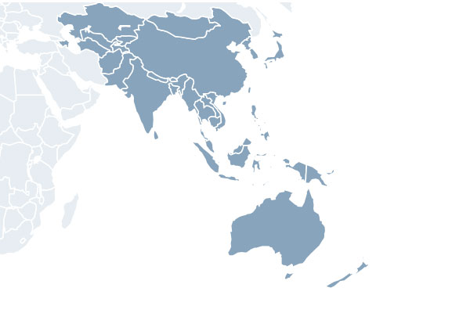
CRVS Data Quality Assessments in Asia and the Pacific

Slide 9

Solomon Islands: Quality of COD Data
Challenges:
  Very Low VSPI score (<0.25)
  Prior to 2015, death registration was less than 2% and 9 different MCCOD forms in use
  Quality audit of 977 MCCOD forms from 2010 - 2014 revealed poor certification practices resulting in very high % of ill-defined COD
Strategies:
  Establishment of National Mortality Committee
  Adoption of international MCCOD form, introduction of ICD-10 manual coding, and MCCOD training for all physicians
  Introduction of verbal autopsy for community deaths
Early results:
  Quality audit of MCCOD forms received over May – Dec 2016 revealed % of ill-defined causes of death is now 9%
Notes:
Previously, all 9 versions of the MCCOD form were not consistent with the international standard, and the certification practice was poor, with the COD often listed as the mode of dying or a vague, ill-defined cause such as ‘old age.’
All medical doctors in the country have been trained on the proper certification of COD and almost all hospitals with a medical doctor are now medically certifying deaths on the newly rolled out form

Slide 10
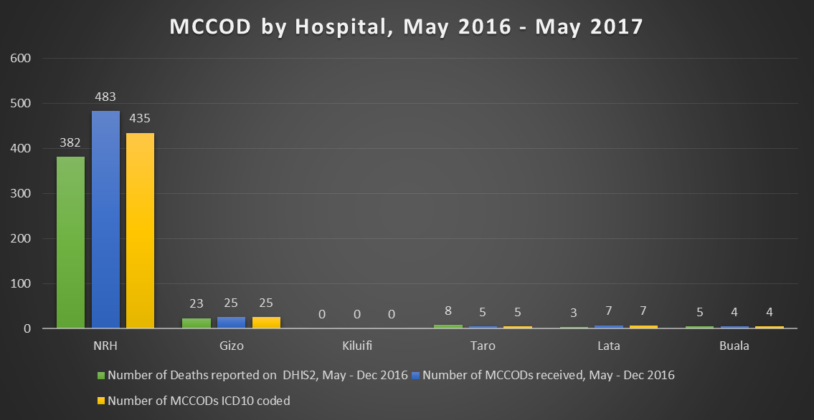
Solomon Islands: Quality of COD Data
Notes:
More MCCOD forms received compared to the number of deaths reported on routine HIS (DHIS2)
Almost 100% of deaths happening in the hospitals with a medical doctor are medically certified since MCCOD was implemented in Solomon Islands within one year
There have been delays observed in getting the MCCOD forms and measures to expedite the process are being worked out
Almost all the MCCOD forms received from hospitals are coded

Slide 11

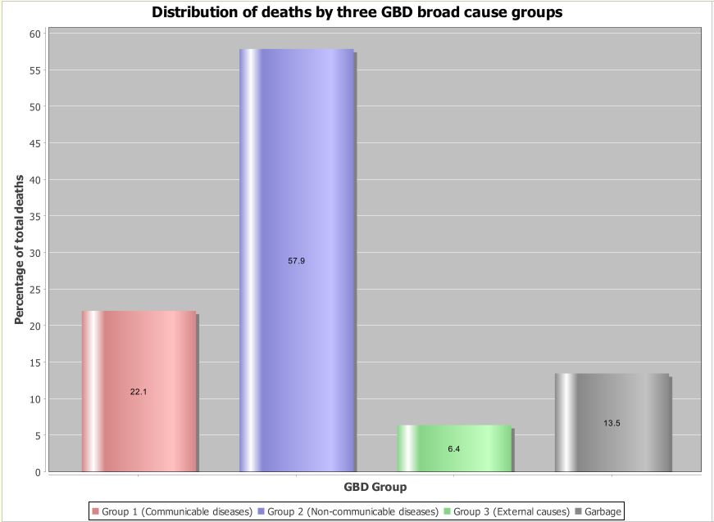
Philippines: Quality of COD Data
Notes:
Baseline assessment data from 2012

Slide 12
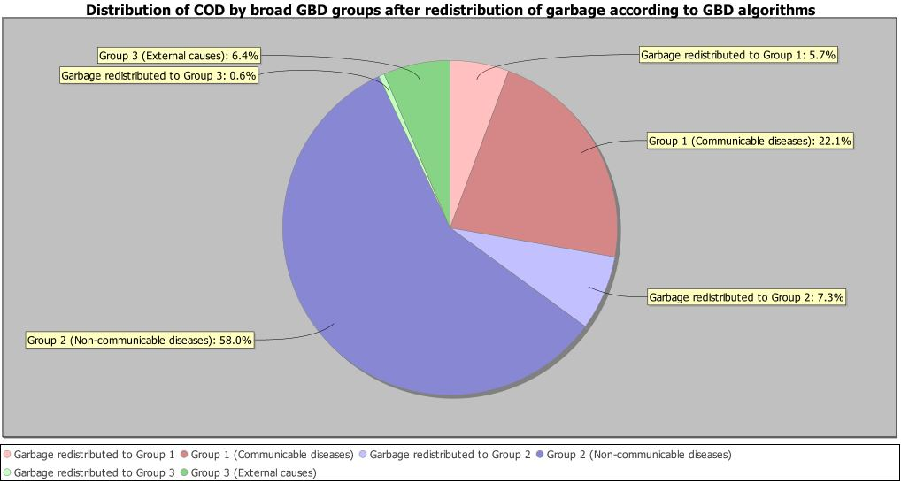
Philippines: Quality of COD Data

Slide 13
Philippines: Quality of COD Data
Challenge:
  Medium VSPI (0.50 – 0.69)
  Quality of mortality data is less useful for policy
Strategies:
  MCCOD training for physicians & Verbal Autopsy for community deaths (PCVA)
  IRIS automated coding
  Improved Governance and Coordination
  ANACONDA
  Estimating completeness of vital event registration
Notes:
Challenge: Medium VSPI: lower quality CoD data and incomplete population coverage
Strategies: the country has identified six interventions to improve system performance that aim to: 1) improve the accuracy of cause of death data; 2) improve the accuracy, efficiency and consistency in ICD coding; and 3) strengthen staff capacity to analyse the quality of CRVS system outputs

Slide 14

Myanmar: Quality of COD Data
Challenges:
  Very low VSPI score (<0.25)
  84% of total deaths are community deaths
  60% death registration completeness
  Over 20% of deaths with ill-defined COD
Strategies:
  Strengthen capture and reporting of vital events
  MCCOD training for physicians
  Verbal Autopsy for community deaths
  Improve ICD-10 coding practices
Source: Population Health Metrics 2017
Notes:
Very low VSPI: Most of these countries only report data sporadically and for only a fraction of all deaths that occur. Any cause-specifi c mortality data reported from these countries usually comes from hospitals. For the remaining 60 or so countries, most of which are in Africa, civil registration systems are either non-existent or so weak that data are not compiled or reported

Slide 15
Myanmar: Quality of COD Data
5,581 VA collected from Jan to May 2017
Pilot: 14 townships representing 4.6% of population
National Rollout: expand to additional 34 townships
Notes:
VAs mostly in adults: (5356 adults)
Pilot: 14 townships with a population of ~ 2.4 million
Phase 1 national rollout: Total 48 townships ~ 8.6 million or 16% of total population

Slide 16

Questions?
https://www.bloomberg.org/program/public-health/data-health/
http://mspgh.unimelb.edu.au/dataforhealth/resources
Ashley Frederes
    Afrederes@vitalstrategies.org
Martin Bratschi
    Mbratschi@vitalstrategies.org

