Slide 1
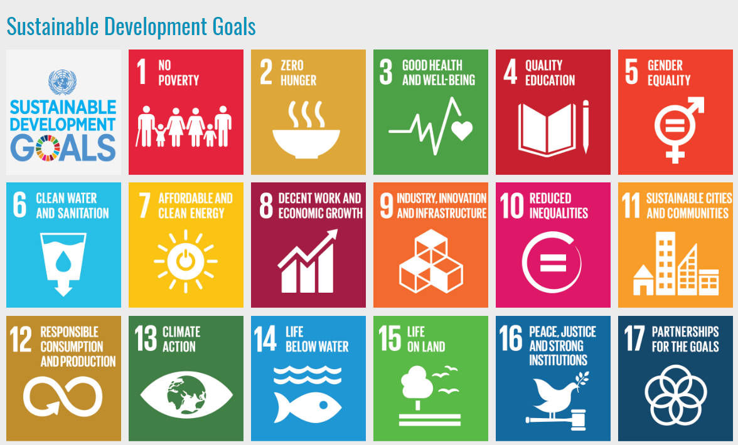

Slide 3



SDG Indicators take data directly from CRVS
3.1.1 Maternal mortality ratio
3.1.2 Proportion of births attended by skilled health personnel
3.2.1 Under-five mortality rate
3.2.2 Neonatal mortality rate
16.9.1 Proportion of children under 5 years of age whose births have been registered with a civil authority, by age
17.19.2 Proportion of countries that (a) have conducted at least one population and housing census in the last 10 years; and (b) have achieved 100 per cent birth registration and 80 per cent death registration
Key:
Tier 1
Tier 2
Tier 3

Slide 4
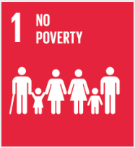
SDG Indicators take data directly & indirectly from CRVS
1.3.1 Proportion of population covered by social protection floors/systems, by sex, distinguishing children, unemployed persons, older persons, persons with disabilities, pregnant women, newborns, work-injury victims and the poor and the vulnerable
1.5.1 Number of deaths, missing persons and directly affected persons attributed to disasters per 100,000 population
3.4.1 Mortality rate attributed to cardiovascular disease, cancer, diabetes or chronic respiratory disease
3.4.2 Suicide mortality rate
3.6.1 Death rate due to road traffic injuries
3.7.2 Adolescent birth rate (aged 10-14 years; aged 15-19 years) per 1,000 women in that age group
3.9.1 Mortality rate attributed to household and ambient air pollution
3.9.2 Mortality rate attributed to unsafe water, unsafe sanitation and lack of hygiene (exposure to unsafe Water, Sanitation and Hygiene for All (WASH) services)
3.9.3 Mortality rate attributed to unintentional poisoning
Tier 1
Tier 2
Tier 3

Slide 5




SDG Indicators take data directly & indirectly from CRVS
5.3.1 Proportion of women aged 20-24 years who were married or in a union before age 15 and before age 18
11.5.1 Number of deaths, missing persons and directly affected persons attributed to disasters per 100,000 population
13.1.1 Number of deaths, missing persons and directly affected persons attributed to disasters per 100,000 population
16.1.1 Number of victims of intentional homicide per 100,000 population, by sex and age
16.1.2 Conflict-related deaths per 100,000 population, by sex, age and cause
Tier 1
Tier 2
Tier 3

