Slide 1


Role of Health Institutions in Vital Registration
Dr. Nyein Aye Tun
Assistant Director
Department of Public Health
Ministry of Health and Sports

Slide 2
Outline
Background of CRVS
Current Vital registration System
Role of Health Institutions
Other related sectors
Strengths
Cause of Death
Ways Forward

Slide 3
Background of VRS in Myanmar
Vital registration system started since early 19th century
By 1931, the vital registration system covered about 80% of population in the country
Disrupted during the World War II.

Slide 4
Background of VRS in Myanmar
According to Towns Act (1907)-
Deputy commissioner was empowered to all births and deaths taking place in his ward.
According to villages act (1908)
The village Headperson was empowered to do so.

Slide 5
Background of VRS in Myanmar
At District level
District Health Officer compiled and submitted to the Directorate of Health Services through District Commissioner.
The reports from Municipal area directly sent to the Directorate of Health Services

Slide 6
Background of VRS in Myanmar
After world war II
Vital registration was firstly functioned by vital statistic section under the Directorate of Health Services, Ministry of Health

Slide 7
Background of VRS in Myanmar
New system for VRS was started in 1962
At township and District, filling of births and deaths information forms by health staff and sent to Vital statistic section
Handling of birth and death information, codifying, processing and tabulating the information done by vital section

Slide 8
Background of VRS in Myanmar
Registration of Births and Deaths and issuing of birth and death certificates were done at Hospitals and township health departments

Slide 9
Background of VRS in Myanmar
In 1st October 1964,vital section was handed over to Central Statistical and Economic Department(CSED)(now Central Statistical Organization ) (CSO) under the Ministry of Planning and Finance.

Slide 10
Background of VRS in Myanmar
According to - Statistical Authority Act 34 of 1952, the CSO was mandated to coordinate and integrate statistics and statistical operation

Slide 11
Current Vital Registration System
Introduced in 1962
Modified Vital Registration System in 1998
Reduce the number of forms (13 to 8) as well as size of forms ( Tri foil to A4 size)
Nation – wide establishment was carried out in 2001

Slide 12





The CRVS System in Myanmar
Central Statistical Organization
Medical Officers
Birth certificate
B & D registration Forms
Death Certificate
Burial Certificate
Data Compile, compute and produce statistical year book
B & D registration Books
Until 1964 MOHS took responsible for the entire process of the CRVS system
Then, MOHS and CSO take share accountabilities

Slide 13
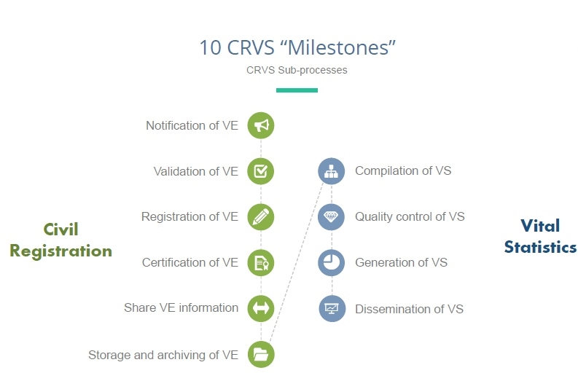
The CRVS System in Myanmar
Roles of MOHS
Roles of CSO

Slide 14
Role of Health Institutions
Central level
Co-ordination & Cooperation with CSO
Supervision , Monitoring & Feedback
State / Regional Level
All forms of Birth and Death received from CSO are distributed to Tsp
Approval for issuing Birth certificates not registered at tsp in time

Slide 15
Role of Health Institutions
Township Level
Main Implementers
Collection of Vital events
Registration & issuing Certificate
Reporting ( send 101 & 201 to CSO)

Slide 16
Community Level
Basic Health Staff (Midwifes)
Notification
validation
Registration
Sent to TMO

Slide 17
Vital Registration System

Slide 18
Cause of Death
Improving the quality and quantity of Causes of Death information for effective health planning and policy making
2012 GBD assessment- Vital Statistic Performance Index Score is very low (0.5) due to low completeness rate, lack of reliable COD Data, quality of age & sex reporting, internal consistency
Low registration coverage - Birth registration completeness (72%) is greater than death (57%)

Slide 19
Cause of Death
Only hospital deaths (16% of total deaths) are medically certified COD by doctors
Reliable COD information for community deaths (84% of total deaths) are not available
Quality of COD information for hospital deaths are poor - 45% of COD information is coded to garbage codes

Slide 20
Cause of Death
Improving the Quantity and Quality of COD information
Provide the Medical Certification of COD trainings to in-service doctors
Embedded the MCCOD curriculum into under and post graduate medical students courses
Using the Verbal Autopsy methods to collect the community COD information through BHS
Using tables to collect the VA in 48 townships across 15 states/region to obtain the representative COD data for Myanmar
Add the VA curriculum into Basic Health Staff courses

Slide 21
Cause of Death
Jointly analyze the data with CSO mainly on COD data and produce the COD distribution reports annually
Maximize the usage of vital statistics and COD information in health planning and policy developing

Slide 22
Cause of Death
General Administrative Department (MOHA)
Department of Immigration and Department of Population (MOL & I)

Slide 23
Linkage with others
CSO conduct regular meeting with all related Departments sharing the reporting status and comparing the vital data
According to reporting status , DOPH gives feed back to State/Regional Health Department & Township Health Department
GAD also gives feedback to tsp/wards/village tract administrators to cooperate with health staff in VRS

Slide 24
Strengths for VRS
Formation of Coordination Committee for VRS up to the grass root level headed by Union Minister , MOHS.
UNICEF ;main organization supports Birth Registration both technical and logistics.
Bloomberg data for Health Initiative supports Death registration especially cause of deaths

Slide 25
Coordination Committee for VRS
Coordination Committee for vital registration and vital statistics up to the ward/village level on 14th January ,2014
-To strengthen and upgrade the VRS in accordance with international standard
- To make the vital registration system more complete and reliable for population update
- To enhance the collaborative activity of involved sectors in vital statistics report

Slide 26
Main activities supported by UNICEF
Amendment of vital registration manual for improving accessibility and availability
Capacity development of Health Staff in Birth registration
Birth registration campaign
Roll out plan for e-platform system ( paper based to computerized system)

Slide 27
Main Activities supported by Bloomberg
MCCOD (Medical certification of cause of death) training to Medical officers both pre service and in service.
Verbal autopsy training to Basic Health Staff both pre service and in service

Slide 28
Ways Forward
Nation wide development and implementation of electronic data based system
Providing adequate training to medical doctors and coders (CSO staff)on the principles of ICD for certifying and coding causes of death
Establishment of data management, feed back and regular data quality assessment mechanism

Slide 29
Ways Forward
Conduct regular VR training for health staff
Training all health workers in health facilities and communities in conducting verbal autopsy for cause of death ascertainment
Improving public awareness on benefits from and responsibilities towards registration.

Slide 30


