Slide 1
The Asian and Pacific CRVS Decade (2015-2024) and the Regional Action Framework
Workshop on the operation of CRVS
and Identity Management systems in East Asia,
Hanoi, 13-17 November 2017

Slide 2






Background
Aims to accelerate efforts of Governments and development partners to realize the shared vision that:
“By 2024, all people in Asia and the Pacific benefit from universal and responsive CRVS systems that facilitate the realization of their rights and support good governance, health and development”
Developed through a consultative process under the leadership of the Regional Steering Group on CRVS
Adopted at the Ministerial Conference on CRVS in November 2014
Notes:
Other outcomes of the Ministerial Conference:
A Ministerial Declaration to ‘Get Every One In The Picture’
Asian-Pacific CRVS Decade (2015 – 2024)
Ministerial Declaration:
(i) “Recognizes the valuable role of subregional programmes to improve civil registration and the vital statistics and the implementation of the present declaration, particularly for addressing unique subregional challenges”
(ii) Notes the need to “establish effective and sustainable national civil registration and vital statistics coordination mechanism, develop a national improvement strategy” as per specific objective 1 of PVSAP
(iii) Recognizes the role of development partners including the “subregional organizations including the …..initiatives such as the Pacific Vital Statistics Action Plan (2011-2014) under the auspices of the Brisbane Accord Group, to promote subregional cooperation for the improvement of civil registration and vital statistics”

Slide 3




Main components
Regional Action Framework contains
3 Goals
15 targets set individually by countries
6 key principles
7 action areas
8 Implementation Steps
Universal
civil registration
Accurate, complete
and timely vital statistics
All individuals are provided with legal
documents to claim identity and ensuing rights
Notes:
The Regional Action Framework have 7 areas of action, and under each of the goals a framework of targets that each country would set individually, for example by 2024, 99% of births shall be registered and 80% of deaths shall be registered.
The Regional Action Framework takes into account the uneven progress with improving CRVS systems and allows for countries to set their respective national targets. It notes the need to improve both the quality and reliability of data on cause of death and completeness of birth and death registration and contains targets under goal 1 “universal civil registration of births, deaths and other vital events”
Goal 3 addresses the “accurate, complete and timely vital statistics (including cause of death) are produced based on registration records and are disseminated”

Slide 4




Goals
Universal civil registration of births, deaths and other vital events;
All individuals are provided with legal documentation of civil registration of births, deaths and other vital events, as necessary, to claim identity, civil status and ensuing rights
Accurate, complete and timely vital statistics (including causes of death) are produced based on registration records and are disseminated

Slide 5
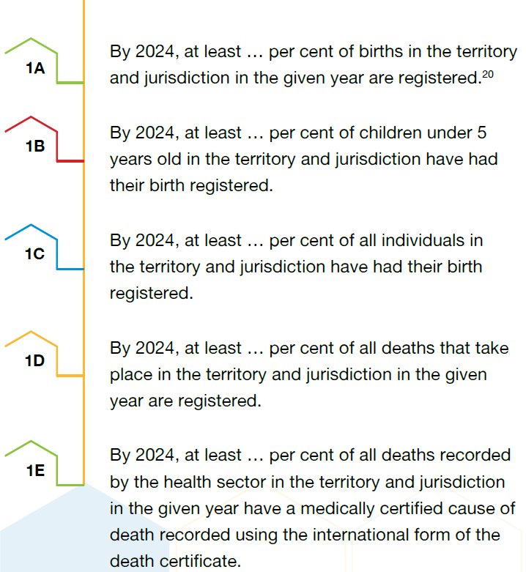
Targets: Goal 1

Slide 6
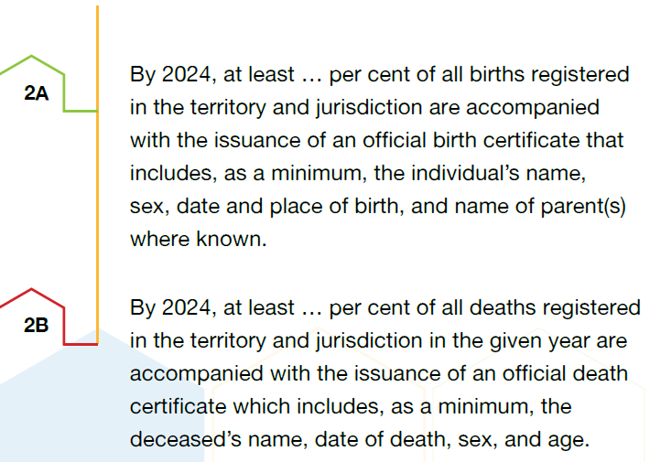
Targets: Goal 2

Slide 7
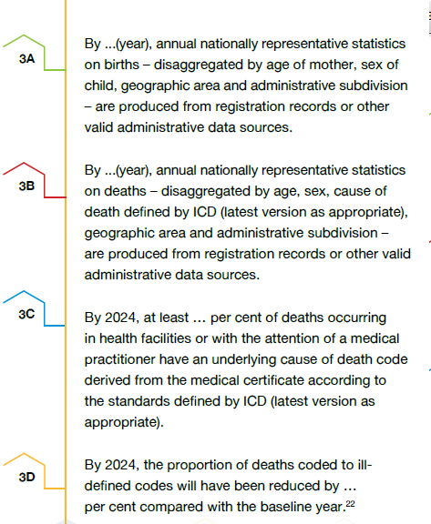
Targets: Goal 3

Slide 8
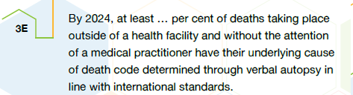
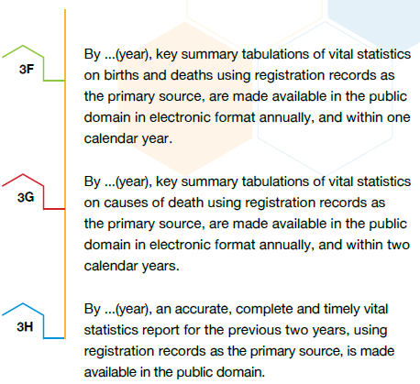
Targets: Goal 3

Slide 9
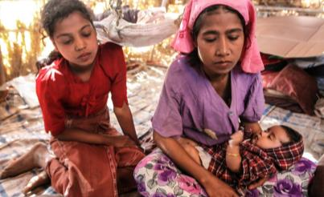
Key Principles
Countries take the lead
A stepwise approach
Flexibility and responsiveness
Building on local expertise
Consistency with international legal principles
Coordination and alignment

Slide 10

Action Areas
Political commitment
Public engagement and participation
Coordination
Policies, legislation and implementation of regulations
Infrastructure and resources
Operational procedures, practices and innovations
Data quality, production, dissemination and use of vital statistics

Slide 11

Implementation steps
Assign a national focal point
Establish national CRVS coordination mechanism
Conduct a comprehensive assessment
Set the national target value for each target
Assess inequalities related to CRVS experienced by subgroups of the population, and, where appropriate, set national targets to address those inequalities
Develop a comprehensive multi-sectoral national CRVS strategy
Develop and implement a plan for monitoring on achievement of the national targets
Report relevant information to the ESCAP secretariat

Slide 12
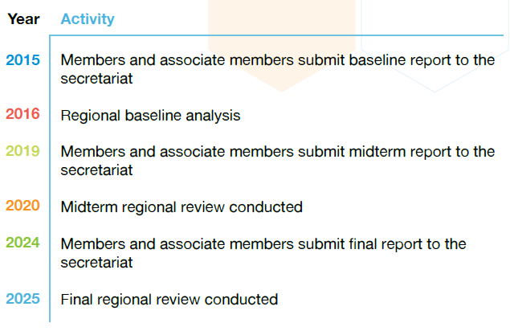
Reporting and Regional Reviews

Slide 13
Country | National CRVS focal point | National Baseline report submitted to ESCAP? | National CRVS Coordination mechanism established ? | Comprehensive CRVS assesment | CRVS strategy
Cambodia | Mr. Heng Sophat | Yes | Yes, 2017 | Yes, 2015 | Yes, 2017
China | No | No | ? | ? | ?
Indonesia | Mr. Maliki | Yes | Yes | Yes | Yes, 2017
Lao PDR | Ms. Kommaly Vilaphanh | Yes | Yes | Planned | Yes
Malaysia | Ms. Norehan Binti Hj. Abdullah Ms. Ida Murni Binti Muhammad | Yes | Yes | Yes | Yes
Myanmar | Mr. Tun Hla Aung | Yes |  | Planned | Planned
Thailand | Mr. Vichian Chidchanognarth | Yes | Yes | Yes | No
Viet Nam | Mr. Nguyen Cong Khanh | Yes | Yes, 2017 | Yes, 2015 | Yes (covers the period 2017-2024)

Slide 14
Thank you! For more information, please visit: www.getinthepicture.org

Slide 15
National Focal Points
One of the implementation steps of the Regional Action Framework
The Role includes
liaising with the ESCAP secretariat to report and monitor progress in implementing the Regional Action Framework
on behalf of all CRVS stakeholders in the country
Crucial role in the implementation of the Regional Action Framework
Notes:
Focal points not identified in China. All other participating countries (Cambodia, Indonesia, Laos, Malaysia, Myanmar, Thailand and Viet Nam) have identified focal points

