Slide 1








COOK ISLANDS
Claudine henry-anguna
PCRN MEETING 2017 – CRVS for Disasters

Slide 2
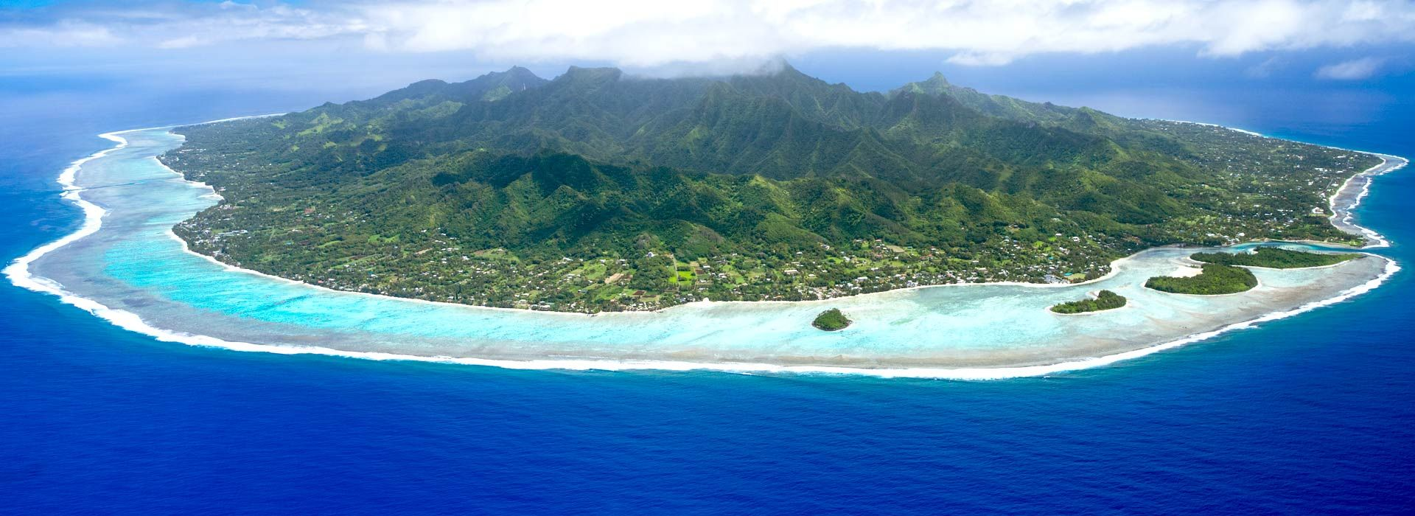
COOK ISLANDS
15 Islands (9 Southern group; 6 Northern group). Halfway between Hawaii and New Zealand
Population 17,459 (2016 Census)
  75% Rarotonga (main island)
  19% Southern
  6% Northern
Exclusive Economic Zone
(EEZ) – 2,000,000 sq km
GDP 100.6m(MarchQ2017)
Self-governing in free
association with New Zealand

Slide 3
BIRTH REGISTRATION
Birth Registration is 100% complete (within 14 days from the date of birth of the child)
100% of the total population have had their birth registered
Birth certificates are provided for all births
  Births and Deaths Registration Act 1973
  Notification of Birth – Ministry of Health to the Ministry of Justice (Registry)
  Expectant mothers from some of the Outer Islands are transported to the main Island
  Public Notices – via use of media to announce births (Major sponsor - Vonnias Ltd – retail outlet provides baby starter/gift packs; radio air time for Ministry of Health nurses reporting from the maternity ward)

Slide 4

BIRTH REGISTRATION (cont.)
  Financial Incentives – Baby ‘bonus’ $1,000NZD; Child Welfare fortnightly allowance - up to age 12 (to be raised up to age 16 for those requiring special assistance; those with disability)
  Proof of Identity – access to child welfare allowance, bank accounts, passport, school registration etc
  Birth Registration is free
  Issuance of Birth Certificate – prescribed fee payable

Slide 5
Death registration
Death Registration is 100% complete (within 3 days after the day of burial)
Cause of death (from a medical certificate) is provided for 100% of all deaths
  Notification of Death – sharing of information between MoH & MoJ
    NZ & Cook Islands Agreement 2016 – sharing of death and name change information
  Public Notice (TV, radio, newspaper, social media - Cook Islands Bereavement Notices and Memorials Facebook)
  Access to Welfare assistance (funeral expenses)
  Access to Land ownership/trust funds

Slide 6
CRVS Committee
Ministry of Health (MoH), Ministry of Justice (MoJ), National Statistics Office (NSO)
‘Informal’ but very active committee.
The Cook Islands Strategy for the Development of Statistic (CSDS) and Health Information Plan 2015-2019
Cook Islands country targets have been set under the Regional Action Framework (RAF)
The National CRVS focal point for RAF is the Registrar (MoJ)
The Registrar (MoJ) is also a member on the CRVS Asia-Pacific Regional Steering Group

Slide 7
DATA storage and Protection
CR data storage:
MoJ (Rarotonga) – electronic and paper records
  Daily back up to e-Gov server and hard drive
Outer Islands – paper record
Central government – OPM’s office (ICT office)
Digitised CR record
Agreement between Cook Islands and Family Search – Creating and Sharing digital images (2016)

Slide 8
Major challenges FOR CRVS
(pre and post Disaster)
Need to upgrade IT system
  This avoids duplication of data and will improve information sharing between relevant agencies/countries
  Mechanism to alert agencies of events which requires appropriate action eg) Birth registration auto-alerts Ministry of Internal Affairs of pending Child Welfare application. (Let the fingers do the walking)
  Manatua subsea cable system (2019) between Samoa and French Polynesia – linking network to the Cook Islands (Rarotonga & Aitutaki) and Niue. Improved connectivity/access to CR record/digital imaging. Technological protection and preservation of CR record.
Orientation for new doctors in medical certification:
  Due to a high turnover of medical staff from overseas, new doctors should be provided with written documentation on how to complete a registration of death correctly, and should receive formal orientation in medical certification and correct use of the HIS system

Slide 9
disaster scale up
Need to assess whether there are any requirement for temporary relocation of the registry office.
Our people (like everyone else in the Pacific) are very resilient people. When disaster strikes; we will always find a way to manage our operations and to continue communicating with our key agencies to ensure registration is sustained.
Key challenges include the protection and safe preservation of our records.

Slide 10

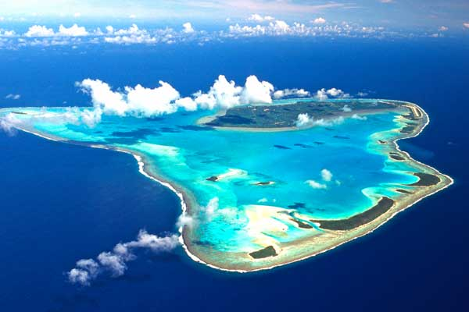



Meitaki ma’ata – thank you

