Slide 1
CRVS Digitisation Guidebook Training Module 1-4

Slide 2
Welcome & Introduction
Notes:
Facilitation Notes:
Introduce the team and the host organisation
Logistics - transport times, tea and lunch breaks, smoking policy, where restrooms are etc.

Slide 3
Introductions
Name
Role
What is your department / authority responsible for in relation to CRVS?
What are your expectations of this training?
Notes:
Facilitation Notes (45 mins):
Drawing game:
Find a person in the room who you don't know, draw the person you meet, and find out the answers to the questions included in the slide.
Introduce your partner to the room with the information gathered (1minute max)
After all participants have introduced each other; ask them how they felt when doing the exercise. The purpose is to make you feel a little uncomfortable, see that everyone works sees things in a different way, and that we should consider these facts throughout the workshop.

Slide 4
Agenda
Monday
Introduction to CRVS Digitisation and the Guidebook
Look ahead: what does the future hold for CRVS Digitisation in your country?
Digitisation inspiration
Tuesday
How to: effectively prepare for a CRVS Digitisation project
The CRVS Ecosystem: an enterprise architecture approach
Business Process Analysis: Why and how to analyse CRVS processes
Wednesday
What opportunities and limitations exist that will inform CRVS Digitisation plans?
CRVS innovations: a design-thinking session
Developing target CRVS processes
Thursday
How to: Develop useful information requirements
How to: Develop a future state system architecture
System requirements: a user-centred approach to developing digital CRVS system requirements
Friday
Fail to prepare, prepare to fail: effective implementation planning
Making the case for CRVS Digitisation
Special Topics
Automation to what level?
OpenCRVS demo
System integration & interoperability
Open source vs. proprietary software
Principles for Digital Development
Solutions for Death Reg. & Verbal Authority
Country break-out
Notes:
**UPDATE TO REFLECT THE SESSIONS THAT YOU WILL INCLUDE IN THE TRAINING – DEPENDENT ON LENGTH OF TRAINING, PARTICIPANTS AND NEED**
Facilitation Notes:
Introduce participants to the agenda for the week (at a high level).
Special Topics
The content of these sessions may vary based on who is conducting the training and where their expertise lies. Update this to reflect any relevant areas that may be interesting for participants. The ones currently included were used in the first CRVS DGB training.

Slide 5
Training Principles
Open
Interactive
Collaborative
Strategic
Fun
Notes:
Facilitation Notes (10mins):
Introduce the training principles
Ask participants what kind of ground rules we should have e.g. no computers, no phones during sessions, be respectful etc.

Slide 6
Tools | Bizagi for Business ProcessModelling
Step 1: Go to https://www.bizagi.com/en/how-we-help/process-modeling
Step 2: Download the free software. There is no cost but you will need to register using your email address and you must create a password. Write these details down as you will need them when you first start using the software.
Step 3: Install and then open up the program
Step 4: Sign in using your email address and password
Step 5: To make sure the software is registered correctly Go to “File” > “New” > “Blank model”
Notes:
Instructions for facilitator:
This tool is needed for a later session but installing the tool needs to happen prior to the session as it takes too long to download, install and register via email.
Suggest asking people to do this:
1) before they arrive for the workshop
OR if they have not done so, then this is their “homework” at end of first day (Leave aside time to do this)

Slide 7
Module 1: Introduction to CRVS Digitisation & the CRVS DGB
Notes:
Facilitation Notes:
In this module you will be introduced to the topic of CRVS digitisation, the CRVS DGB and be shown how to use the DGB.

Slide 8
Why is CRVS Digitisation Needed?
Notes:
Facilitation Notes:
Ask participants to individually, on a post-it note, identify 3 risks of not digitising CRVS systems.
Select a few participants to read out their risks to the group.
Gather the post-it notes and put them on the “Business Case” poster that is on the wall.

Slide 9
3 Key Questions
When do we identify the need for a CRVS Digitisation project?
Why may ICT projects fail to deliver?
How can the CRVS Digitisation Guidebook help?
Notes:
Facilitation notes:
Most countries are at some stage of digitisation. The following introductory slides will help you answer the following 3 questions (as per the slide).

Slide 10
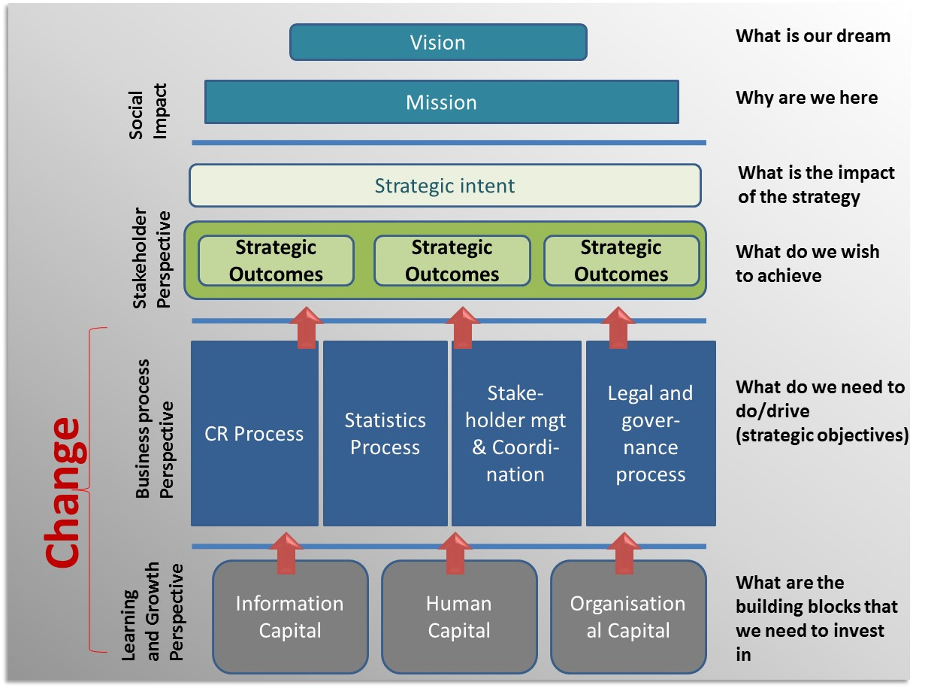
When do we identify the need for a CRVS digitisation project?
Notes:
Facilitation notes:
Talk through the diagram included on the slide showing the hierarchy of CRVS strengthening activities, and where digitisation fits into this process.
“Information capital”, or “digitisation, is one of the ways in which to support a CRVS vision and must be viewed as part of a wider ecosystem that helps the business (in this case, CRVS) achieve its vision and mission in the most effective way.

Slide 11
We must not invest in ICT without first conducting proper planning and analysis
Notes:
Facilitation notes:
If we want ICT to support achieve the organisational vision and mission …we should not start implementing anything until we have conducted proper planning and analysis
For example, we should not develop a birth registration solution without first understanding how this fits within the holistic view of CRVS, including all other life events and the provision of vital statistics.
So how do we conduct such planning and analysis? …

Slide 12
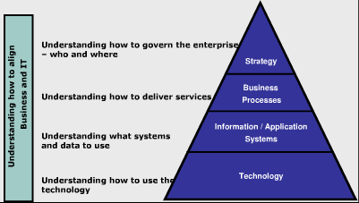
Aligning the business (CRVS) with IT
Notes:
Facilitation notes:
CRVS Digitisation should respond to business need and requirements. In this case, the “business” is CRVS. As such, you can see from this hierarchy that:
You must be driven by what the business does, who is involved it, and what their strategy and aims are.
Based on this, you will identify what services are offered to help achieve these strategic aims.
You will then consider how to support these processes, and what information/application systems are required.
ONLY then do you consider what technology to use to do this…
Before moving on to the next slide, ask participants why they think ICT projects fail:

Slide 13
Why may ICT projects fail to deliver?
Poor programme / project governance
Unclear business / system requirements
Inappropriate use of technology
Inadequate skills and resources
Leads to costly, underperforming systems that don’t match the business need!
Notes:
Facilitation notes:
Poor project governance and vague objectives can be disastrous. Particularly in the case of CRVS, which is inter-disciplinary, this leads to a lack of consensus about what the project is trying to achieve. This risks leading to misunderstanding and disappointment later in the implementation.
Unclear system requirements – writing good system requirements is difficult - if system requirements are not clear then much time and money will be lost in designing and then redesigning ICT solutions
Inappropriate use of technology – this may happen if the technology is selected before understanding what the solution must do, typically referred to as “a technology solution looking for a problem”. For example, selecting a software which is high performing but requires a level of infrastructure which is not widespread in-country.
Inadequate skills and resources – if we don’t have the right expertise in the right numbers, then the end-product will reflect the quality of the skills and resources available.

Slide 14
What is the CRVS Digitisation Guidebook?
Online step-by-step guide for countries to plan, analyse, design and implement digitized CRVS systems
Includes skills required, guides and country examples
Developed in collaboration with country experts across Africa
Living resource that will continue to evolve and expand over time
Complementary to other resources
www.crvs-dgb.org

Slide 15
Guidebook Principles
ICT as an enabler
Smart implementation planning
Strong project governance
Notes:
Facilitation notes:
ICT as enabler: ICT solutions must be seen as enablers and directly support the business functions of CRVS. The alignment of ICT to business need is at the core of Enterprise Architecture methodologies and this Guidebook takes inspiration from such approaches, presenting them in a simplified and easy-to-use format. For effective enablement of CRVS, ICT solutions and technology choices must be appropriate for the country context and based on a thorough analysis of existing systems and infrastructure, eGov policies, CRVS processes, human capacity and operational procedures.
Smart Implementation planning: CRVS systems must be implemented and deployed in a manner which takes into account the realities of existing CRVS capacity. Where there is a significant gap between current CRVS capabilities and the desired future state, it will be necessary to create an implementation roadmap, such that the scope and timing of change is realistic and manageable. From a technology perspective this means that initial software releases should focus on less complex functionality to build confidence in the systems and that sufficient allowance is made for feedback on system requirements through prototyping, thorough field testing and piloting. In terms of the roles and responsibilities of system users, there will likely be initial resistance to change, so change management activities must be defined that encourage system use and progressively build acceptance of the system through positive communication of system benefits for users and beneficiaries.
Strong project governance: Clear and appropriate governance roles must be established for the CRVS authorities and IT departments involved in the CRVS digitisation project. Common project management documents will also reinforce these roles and a common understanding of the project objectives. Project roles and objectives must also align with those of the broader CRVS strengthening programme, noting that accountability mechanisms are paramount due to the inter-disciplinary nature of CRVS and the large number of stakeholders across different ministries

Slide 16
[INSERT COUNTRY] Experience of the CRVS-DGB
Notes:
Instructions for facilitator: **ASK ANY PARTICIPANT COUNTRY WHO HAS EXPERIENCE USING THE CRVS DGB**
Ask [COUNTRY X] to discuss their experience of working with the CRVS DGB.
What are the top 3 lessons you learned going through the process?
What would you say to other countries interested in using the CRVS-DGB?

Slide 17
How to navigate the CRVS-DGB
www.crvs-dgb.org
Notes:
Instructions for facilitator:
Project the CRVS DGB and show participants how to navigate through the website. Explain the structure, tools, resources etc.

Slide 18
CRVS DGB Treasure Hunt!
Notes:
Instructions for facilitator:
Test participant's knowledge by asking them to navigate to certain locations of the DGB. Prizes for the winners!

Slide 19
Post-Workshop Deliverables
Deliverable 1: Long-term CRVS Digitisation Vision
Deliverable 2: Draft CRVS System Architecture to support long-term CRVS Digitisation Vision.
See the CRVS DGB for examples of these deliverables
Due 1 MONTH after completing this training: [INSERT DUE DATE]
Notes:
Instructions for facilitator: **UPDATE BASED ON WHERE PARTICIPANT COUNTRIES ARE AT AND WHAT IS RELEVANT**
We will cover these activities during the course of the week – this will equip you with the skills and knowledge required to complete these exercises.
If you have these already, can you share them so that they can be included as examples on the CRVS DGB?
Navigate to deliverables in the website so they can find them and know how to download them.

Slide 20
Module 2 Preparation
Notes:
Facilitation notes:
The activities of the preparation phase need to be completed prior to commencing a CRVS digitisation project. This phase includes alignment with a country’s broader CRVS strengthening programme and lays the foundations for a business case for digitised CRVS.

Slide 21
Preparation
Analysis and Design
Implementation Planning
Define a Long-Term Vision for CRVS Digitisation
Initiate CRVS Digitisation project
Document CRVS Digitisation Implementation Plan
Develop a Business Case for CRVS Digitisation
Define the CRVS Business Architecture
Procure the Digital CRVS System
Conduct As-Is Assessment of the CRVS Landscape
Define the Change Management Approach and Plan
Identify CRVS Digitisation Opportunities and Limitations
Define the Deployment Approach and Plan
Document the Target CRVS Processes
Define the Training Approach and Plan
Define the CRVS Information Requirements
Define the Testing Approach and Plan
Define Target System Architecture
Define Operations Approach and Plan
Define System Requirements
Notes:
Facilitation Notes:
Introduce the preparation stage of the toolkit and what the 2 steps are

Slide 22
Define a Long-Term Vision for CRVS Digitisation
Notes:
Facilitation Notes:
The long-term vision for CRVS digitisation sets out a desired future state for CRVS that can specifically be achieved through the use of digital technologies. Aligned with the CRVS Strategic Plan, the long-term vision will be based on high-level needs and will set the direction for the CRVS digitisation project.

Slide 23
…birth registration could be fun?
…civil registration could be conducted cross-borders?
…I could view vital event registration performance on my mobile phone?
…we could use health data for civil registration purposes?
Notes:
Facilitation notes:
Description: a “What If” statement is an idea/inspiration/possibility that you envisage in the area you are working in (might be a “game-changer”). The exercise is designed to get people to think about the possibilities that exist “outside of the box” and without consideration of any existing barriers or orthodoxies.
Purpose: Thinking of “What if” statements allows participants to think beyond the current context in order to be able to think more freely and innovatively. Example: What if I could register any vital event occurrence from my mobile phone?
Activity:
Ask participants to come up with as many “What If” statements as they can in 5 minutes. Each one should be written on a separate post-it note.
Ask each participant to read out each of their statements to the whole group.
Take each post-it note and begin to group them into categories.
Leave 5 mins at the end of the session to discuss the common categories that came up.

Slide 24
Exercise: What enabling factors are needed for CRVS Digitisation to be successful?
Enabling Factor: something that needs to be in place to facilitate / enable CRVS digitisation to be possible.
A dependency: The relationship that defines the order in which tasks are carried out i.e. the relationship of the preceding task with the succeeding task e.g. I need money before I can buy a car.
In mixed groups:
Identify all the enabling factors and critical dependencies required for CRVS digitisation to take place (25 mins)
Present back the top 3 priority areas that will help you move forward with CRVS digitisation
Consider:
Infrastructure
Demand for services & Awareness
Legal & Policy Framework
Coordination & Governance
Interoperability
Resources & Prioritisation
Notes:
Instructions for facilitator:
Description:
It is all well and good to pursue a digital CRVS system, but before you do, you must consider the environment you are operating in, and what things need to be in place to make the digitisation a success.
What are the things that need to be in place to facilitate effective CRVS digitisation? Enabling factors are factors which are needed to make CRVS digitisation successful and possible.
A critical part of the planning process is identification of dependencies. What are these dependencies when it comes to CRVS digitisation?
Note to the groups that they should also consider cross-ministerial dependencies e.g. Civil Registration and Ministry of Health and how they are dependant on each other.
Activity:
In country groups, ask the participants to discuss and capture (on flip charts) what enabling factors are needed for CRVS digitisation to be successful.
Ask each group to present back the TOP 3 items identified, and to explain why these are so important.
After participants have completed the activity, advise them that dependencies should also be identified when planning i.e. the importance of identifying potential challenges ahead of time e.g. you may have designed your system architecture and requirements, but if you don’t have the financing there may be a long extended pause in the progression of your CRVS digitisation project. Consider these items ahead of time!

Slide 25
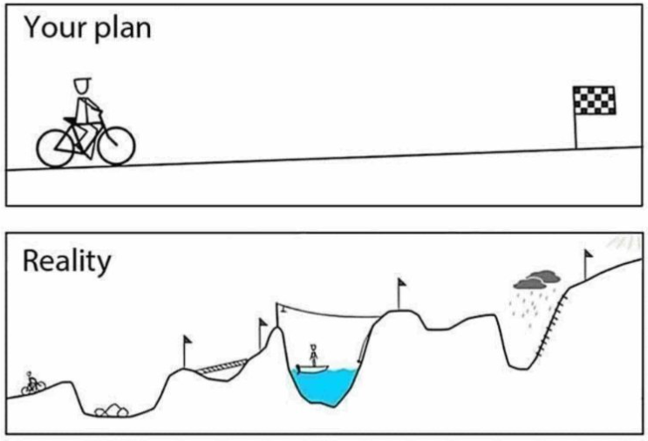
Exercise: When will these enabling factors be in place in your country? 2, 5 or 10 years?
In: Country Groups
For each of the enabling factors you identified, decide whether it will take 2, 5 or 10 years to achieve this (15mins)
Notes:
Facilitation Notes:
Description:
Now that you have identified the things that need to be in place to support CRVS digitisation, you need to think about how long these things will take to achieve in your country.
When considering digitisation options, you need to consider the environment you are operating in, and plan accordingly.
Activity:
For each of the enabling factors identified, whether it will take 2, 5 or 10 years to achieve this.
This should inform the development of your long-term vision.

Slide 26
How Low Can You Go?
Automation to what level?
Notes:
Facilitation Notes:
What do you think this cartoon is saying?
When we think about digitisation, we need to think about the problems it will solve and the need for introducing something new into an environment that might not actually benefit from having it there.
We have invited a few people to briefly explain what level of automation they have gone to and why: [introduce countries who will present their models and explain why].

Slide 27
COUNTRY EXAMPLES
Notes:
If possible, ask participating countries to provide a brief example of how low they have, or are planning to, automate.

Slide 28
Shifo

Slide 29
Exercise: How low can you go?
In country teams:
…you have 25 minutes to discuss and identify:
What 5 factors / constraints will affect or have affected the level to which you can automate?
What level do you currently automate to?
What level do you want to automate to?
Notes:
Facilitation Notes:
Introduce participants to the exercise.
Facilitate a discussion on the different approaches taken by each country.

Slide 30
A Window on the World
Notes:
Facilitation Notes:
A window on the world:
Ask participants what they think of when they see this image.
As you can see from this image, it is very easy to see things differently through a different lens and/or a window. It would be easy for us to just focus on CRVS systems, and think very traditionally about what we can do when it comes to CRVS digitisation. But we must remember, If one explores the many innovations throughout history, it becomes clear that very few innovative ideas are new; the vast majority take something that is already working and improve it, be it a product, service or process. We need to take these existing ideas and explore how they could be relevant for CRVS – look at things through a different window!
Activity:
Cards available on each table, take a card and read it. Think about how this example could be relevant for your CRVS system (5 mins)
Ask participants to, BRIEFLY, introduce the concept and how this might be used to inspire CRVS digitisation.
If the card demonstrates a CRVS solution – how could this be used in your country OR could it not be used? Could it be used for another vital event?

Slide 31
for CRVS Digitisation
Do you have enough resources in your country to complete the full scope of CRVS digitisation work you want to achieve?
What systems is your government investing heavily in?
Does your government fully understand the potential benefits of a robust CRVS system?
Notes:
Facilitation Notes:
CRVS is often not prioritised.
A Business Case will help:
Explain how technology can be a cost-effective means to improve CRVS systems and processes.
Should be used to:
Indicate the expected benefits of CRVS digitisation
Get buy-in from key stakeholders
Justify the technology investment costs
Raise funds for project implementation
Instructions for participants:
Throughout the week, whenever we touch on something that falls into any of these categories, we need to add it to the Business Case poster.
Full exercise at the end of the week, specifically on developing a business case.
Ask one participant to navigate to the business case template in the DGB.

Slide 32
Module 3 Analysis & Design
Notes:
Facilitation Notes:
Description:
The activities of the analysis and design phase provide step-by-step guidance of how to align ICT with the CRVS business need. Following the activities in a sequential manner will ensure that the relevant country context is fully analysed and traceable from the CRVS business requirements through to the detailed requirements for an enabling CRVS system

Slide 33
Preparation
Analysis and Design
Implementation Planning
Define a Long-Term Vision for CRVS Digitisation
Initiate CRVS Digitisation project
Document CRVS Digitisation Implementation Plan
Develop a Business Case for CRVS Digitisation
Define the CRVS Business Architecture
Procure the Digital CRVS System
Conduct As-Is Assessment of the CRVS Landscape
Define the Change Management Approach and Plan
Identify CRVS Digitisation Opportunities and Limitations
Define the Deployment Approach and Plan
Document the Target CRVS Processes
Define the Training Approach and Plan
Define the CRVS Information Requirements
Define the Testing Approach and Plan
Define Target System Architecture
Define Operations Approach and Plan
Define System Requirements
Notes:
Facilitation Notes:
Provide a brief overview of each step of the analysis and design phase.
Use the online version to show participants each step.
You will spend 3 days on the analysis and design

Slide 34
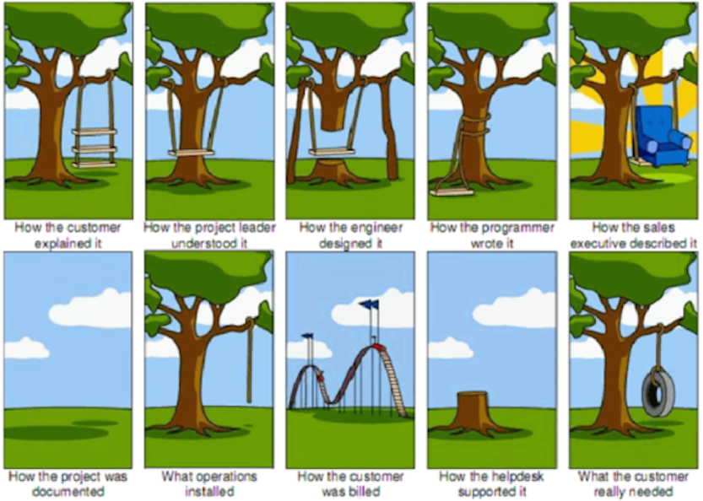
The importance of planning a project properly
Notes:
Facilitation Notes:
Critical to execute a successful CRVS Digitisation Project
Structured manner clearly defining expectations and standards to all relevant actors and stakeholders.
A Project Initiation Document (PID) formally documents the purpose, approach, standards and timelines of the Analysis & Design Phase.

Slide 35
Tool: CRVS-Project-Initiation-Document-PID-Template
Notes:
Facilitation Notes:
Ask a participant to find the PID template in the Guidebook. Are any of the participants familiar with a PID (or similar document?)
Provide a brief overview of each section of the template and why it is important when initiating a CRVS Digitisation Project.
Description: The PID should be shared with all relevant parties so that the scope of work and their roles and responsibilities are acknowledged and accepted before formal work begins. In subsequent activities, this advanced project planning will help guide project decision-making and management and will be updated to reflect the change in focus of activities at the beginning of the Implementation Phase.

Slide 36
Exercise: Project Management & Governance Structure
In country groups:
1.20 mins: Match the names of each role to the function.
2.20 mins: Do you have a digitisation project? If yes, draw your current project management & governance structure on a flip chart.
3.20 mins: Reflecting on the roles defined in the guidebook, create your ideal project management & governance structure. If it remains the same, please explain why.
Notes:
Facilitation Notes:
Introduce each activity in sequence. There will be pieces of paper on each table.
Following activity 1 (15 mins):
Ask participants whether they are aware of each of these roles.
Are all roles needed in a CRVS digitisation project? Why? Why Not?
Following activity 2 (5mins):
Ask each country to present their current governance structure (5mins), highlighting:
Do each of these resources come from one authority? Or are they from multiple depts./ministries?
Which roles does your country not currently have? / are currently not permanent?
Do you think that is a problem? Would it help to have these resources?
Each country should present their governance structure to the room (approx. 5mins)
Following activity 3:
Ask each group to present their future project management and governance structure. Specifically focusing on what has changed and why?

Slide 37
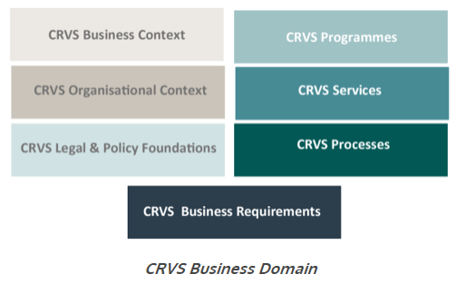
Define the CRVS Business Architecture
Business Architecture: to build a common understanding of the organisation’s purpose, functions and needs in order to guide and manage organisational activities and change.
In this context, the “organisation” comprises those responsible for CRVS.
Foundation of next steps and system architecture.
Notes:
Facilitation notes:
Ask a participant to navigate to this part of the DGB online
Ask all participants what they understand by the term business architecture
Provide introduction of what Business Architecture is and why it is important when considering CRVS digitisation
Any system should respond to business need, and the business architecture helps identify all the key components in your country and context, that need to be considered when designing a CRVS system.

Slide 38
An example from Ghana
Notes:
Facilitation notes: NB. This example should be from one of the participating countries if they have a business architecture already.
30 mins in total
Present the business architecture from Ghana. NB. Participants will have a hard copy to look at so no need to project.
Following the presentation call on the Ghanaian team to explain:
The number of stakeholders involved and why this is so important.
How this exercise helped the rest of CRVS DGB work conducted.
Ask participants for questions and facilitate discussion.

Slide 39
Tool: CRVS-Business-Architecture-Template
Notes:
Facilitation notes:
Ask a participant to find the Business Architecture template in the Guidebook.

Slide 40
Exercise: CRVS Business Context
In country groups, answer the following questions:
Who are the different CRVS actors and stakeholders in your country?
What is each organisation’s role in CRVS?
What are the specific motivations of each of these organisations regarding CRVS?
What are each of these organisations’ operational drivers e.g. cost reduction, improved service delivery etc.?
Notes:
Facilitation Notes:
Description:
Exercise to help determine who the different actors are in CRVS and what their motivations are. This will ensure that these are considered and incorporated into requirements during the CRVS digitisation process.
Activity 30 mins:
Ask the participants to discuss in groups each of the questions defined on the slide.
Each group should write on the flip-charts which will later be used to present by each group. Each group discusses for about 15 min and then present for 5 min per group.
As each group is presenting, note if there are any overlaps. After all groups have presented, bring up the overlaps for conversation and discussion.

Slide 41
Conduct an As-Is Assessment of the CRVS Landscape
Notes:
Facilitation Notes (5 mins for this and next slide):
Ask participants what they understand by an as-is assessment and why this might be important for CRVS digitisation.

Slide 42
As-Is Assessment of the CRVS Landscape
Build a comprehensive understanding of the current situation in order to respond in a relevant manner.
The as-is assessment includes:
Documentation of existing CRVS processes and systems
Identification of process bottlenecks, barriers, and informal practices.
Identification of system strengths and weaknesses
Identification of opportunities and limitations incl. infrastructure and resource capacity
Notes:
Facilitation notes:
An as-is analysis, or situational analysis, is a way in which you can comprehensively understand all factors required to define an appropriate response. IT is about identifying needs, opportunities and limitations, all of which will inform a response or solution that is contextual and fulfils its purpose.
Based on responses gathered, confirm and elaborate on the above points.

Slide 43
Process Modelling
Process models are a communication tool
Diagrams that represent a real-world process with the aim of:
Understanding the AS-IS business process
Establishing a commonly shared perspective
Analysing the process to see where the problems are and where improvements can be made
Representing the TO-BE process
Notes:
Instructions for facilitator:
Present the purpose and importance of an As-Is Assessment of the CRVS Landscape. Use the bullet points on the slide as guidance as well as:
In order to identify appropriate technologies to support CRVS, an “As-Is” assessment must be conducted to understand the strengths and weaknesses of the existing CRVS Landscape, including several components documented in the Business Architecture e.g. CRVS business processes. Basing subsequent technology decisions on these findings will ensure that technology interventions directly address identified weaknesses.

Slide 44
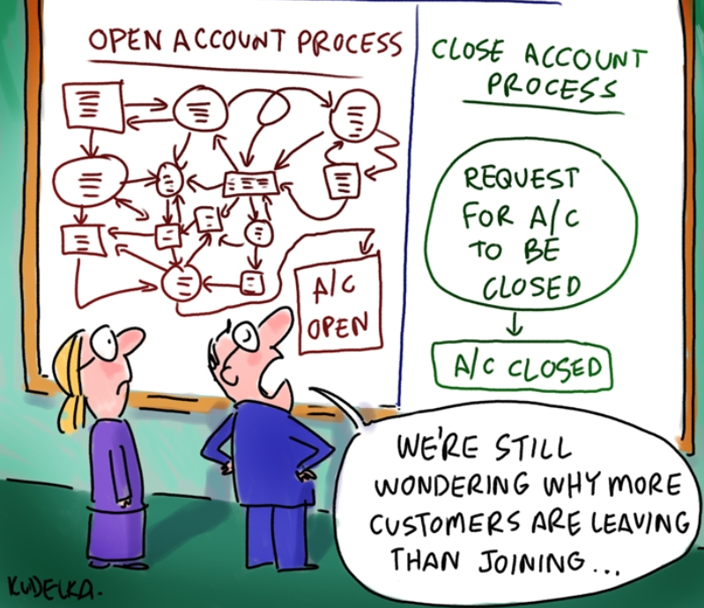
Notes:
Facilitation notes:
Ask participants what this cartoon means?
A diagram can show a lot of information in a way that is more easily communicated than reading a lot of text
A bpm can be used to analyse how to make the process more efficient and effective

Slide 45
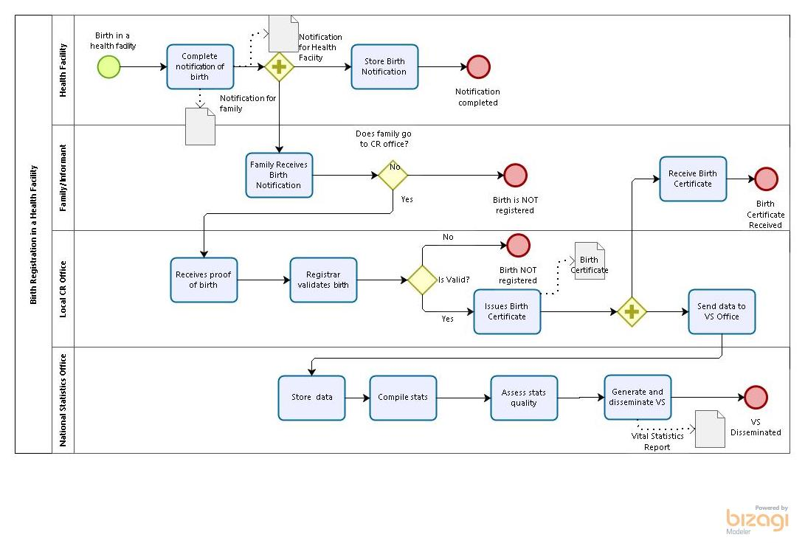
Business Process Modelling
Notes:
Facilitation notes:
Explain to the group how this is an example of a business process map that may be used for the As-Is Assessment of the CRVS Landscape.
Explain the group will be doing exercises to familiarize themselves with how to use this tool and create a map like this.

Slide 46
Business Process Modelling – How To
Define boundaries – the start and end point/s
List the steps in between
Use a verb / action to describe
Start with high level first
Put steps in order
Use appropriate symbols
3. Check the whole process
Notes:
Facilitation notes:
Link to the CRVS-DGB site - show them the Business Process Modelling Guide and example diagrams
Explain that this can be done on a whiteboard, flip chart or using post-it notes initially
Explain that there are a number of BPM tools available (VISIO, draw-io, Enterprise Architect) and the benefit of these are that they can be shared and updated easily

Slide 47
Tool | Using Bizagi
Step 1: Go to https://www.bizagi.com/en/how-we-help/process-modeling
Step 2: Download the free software
Step 3: Open up the program
Step 4: Go to “File” > “New” > “Blank model”
Step 5: Go to “Save as” > “Computer” > “Save” > Select a location on your laptop to save the file
Step 6: Continuously save the file as you are working in it during the next session.
Notes:
Facilitation notes:
This section is intended to give the participants an introduction to using a simple BPM tool that is recommended - freely available and easy to use.
The next slides will introduce them to Business Process Mapping Notation in Bizagi. Explain to delegates that they will do an exercise to map a CRVS process
NOTE: This download preferably needs to happen prior to session as it takes too long to download, install and register via email.
Suggest asking people to do this before they arrive / when they first register at beginning of workshop / as “homework” at end of first day
If they have not already done so, then allow 20 minutes at least for this process

Slide 48
Business Process Modelling Notation | BPMN
A Pool is a container of a single process
A Swim Lane represents responsibilities: to distinguish which departments or employees are responsible for each set of tasks
A Start Event indicates the beginning or initiation of a process
An Intermediate Event indicates something that occur or may occur during the course of a process between the start and the end
An End Event indicates where a process will end
A Task is a simple activity
A Sequence Flow shows the order that tasks will be performed
Notes:
Facilitation notes:
Explain what each symbol is used for and use examples to illustrate
Pools represent the process and Swim Lanes represent roles/responsibilities
We can identify 3 types of elements that describe the process behavior:
Tasks represents the work that is performed, represented by rectangles
Events that are used to identify the start and end of the process, represented by circles
Decision elements, known in BPMN as gateways, that are represented by diamonds
The flow or sequence is which processes occur is indicated by an arrow

Slide 49
Business Process Modelling Notation | BPMN
Gateways manage divergence and convergence of flows – SPLIT & MERGE
An Exclusive Gateway - The process has two or more sequence flows and only one can be taken (EITHER / OR )
A Parallel Gateway - The process has two or more sequence flows and ALL of them are taken
Merge - the gateways waits for all incoming flows before the process continues
A Data Object represent the exchange of information (paper based)
Indicates where a database is located (paper or electronic)
Annotation provides additional information about the process
Notes:
Facilitation notes:
Exclusive gateway - chooses one of the possible paths based on process data. (EITHER/ OR)
Parallel gateway - two or more processes happen in parallel/ at he same time (AND)
Data objects represent data coming into or out of the process - typically forms, certificates, reports, etc.
Annotation is used to contain extra details about the process

Slide 50
EXERCISE | Mapping a Birth Registration Process
Create a process named “Birth in a Health Facility”
Add the following stakeholders
• Family/Informant
• Health Facility
• Local Civil Registration Office
• National Statistics Office
3. Include a Start Event: Birth in a Health Facility
Notes:
Facilitation notes:
(NB: Have a printout of the exercise steps available to refer to when using Bizagi)
Map this process together with the whole group. Take the group through each step and show everything on projector. Leave time for questions to make sure everyone understands.

Slide 51
EXERCISE | Mapping a Birth Registration Process (continued)
4. Add the following tasks:
• Midwife fills a notification of birth
• Parallel Gateway
• One copy of the birth notification is given to the family
AND
• One copy of the birth notification is stored in the health facility
Notes:
Facilitation notes:
Map this process together with the whole group. Take the group through each step and show everything on projector. Leave time for questions to make sure everyone understands.

Slide 52
EXERCISE | Mapping a Birth Registration Process (continued)
5. Add the task: Family receives the birth notification
6. Add an exclusive gateway (EITHER/OR) Family continues the process?
• If YES: Family goes to the Local Civil Registration Office
• If NO:
Birth is NOT registered
7. Add the task: Birth Registration Office receives the proof of birth from the family
Notes:
Facilitation notes:
Map this process together with the whole group. Take the group through each step and show everything on projector. Leave time for questions to make sure everyone understands.

Slide 53
EXERCISE | Mapping a Birth Registration Process (continued)
8. Add the following tasks:
• Registrar validates the vital event
• If VALID:
Registrar registers the birth in the Birth Register
AND
Issues a Birth Certificate
• If NOT VALID:
Birth is NOT registered
• Birth Registration Office enters the data in an online CRVS platform
Notes:
Facilitation notes:
Map this process together with the whole group. Take the group through each step and show everything on projector. Leave time for questions to make sure everyone understands.

Slide 54
EXERCISE | Mapping a Birth Registration Process (continued)
9. Data is stored directly in a central server at the
National Statistics Office
10. Add the following tasks:
• National Statistics Office compiles Vital Statistics
• National Statistics Office checks quality of VS
• National Statistics Office generates and disseminates VS
Notes:
Facilitation notes:
Map this process together with the whole group. Take the group through each step and show everything on projector. Leave time for questions to make sure everyone understands.

Slide 55
EXERCISE (Individual) | Mapping a business process
Create a new business process model diagram in Bizagi
Map a CR business process that you are familiar with:
Example:
Birth registration where birth occurs at home
Death registration where death occurs in a facility
Notes:
Facilitation notes:
Activity: (30 minutes)
Allow time for the participants to practise using Bizagi on their own or in small groups, with facilitators to assist where needed

Slide 56
Identification of barriers and bottlenecks
Identify process bottlenecks, inefficiencies, delays and informal practices.
Assess the capacity of actors to conduct current process steps.
Identify registration barriers i.e. reasons why citizens do not actively register vital events.
Barrier: An action or inaction which prevents an individual from entering or completing the process
Bottleneck: An action or inaction which negatively affects the process
Notes:
Facilitation notes:
Give the group a brief introduction about identification of barriers and bottlenecks. What is the difference between the two? Why is it needed?
Barrier: An action or inaction which prevents an individual from entering or completing the process
Bottleneck: An action or inaction which negatively affects the process
It is important to do an analysis of barriers and bottlenecks to learn what is working well in the current process, what needs improvement (bottlenecks) and what needs to be completely removed or resolved (barriers). Understanding this context is crucial to be able to develop a target system that will work well and not recreate the problems previously faced.

Slide 57
Exercise | Identify Barriers and Bottlenecks
Based on your experience, which of the below are barriers or bottlenecks?
The mother can notify the birth at the hospital
The closest Birth Registration Office is 10km from the mother´s home.
The birth certificate costs the equivalent of 2 USD.
The Birth Registration Office is sometimes closed during work days due to staff having to work in multiple locations.
Barrier: An action or inaction which prevents an individual from entering or completing the process
Bottleneck: An action or inaction which negatively affects the process
Notes:
Facilitation notes:

Slide 58
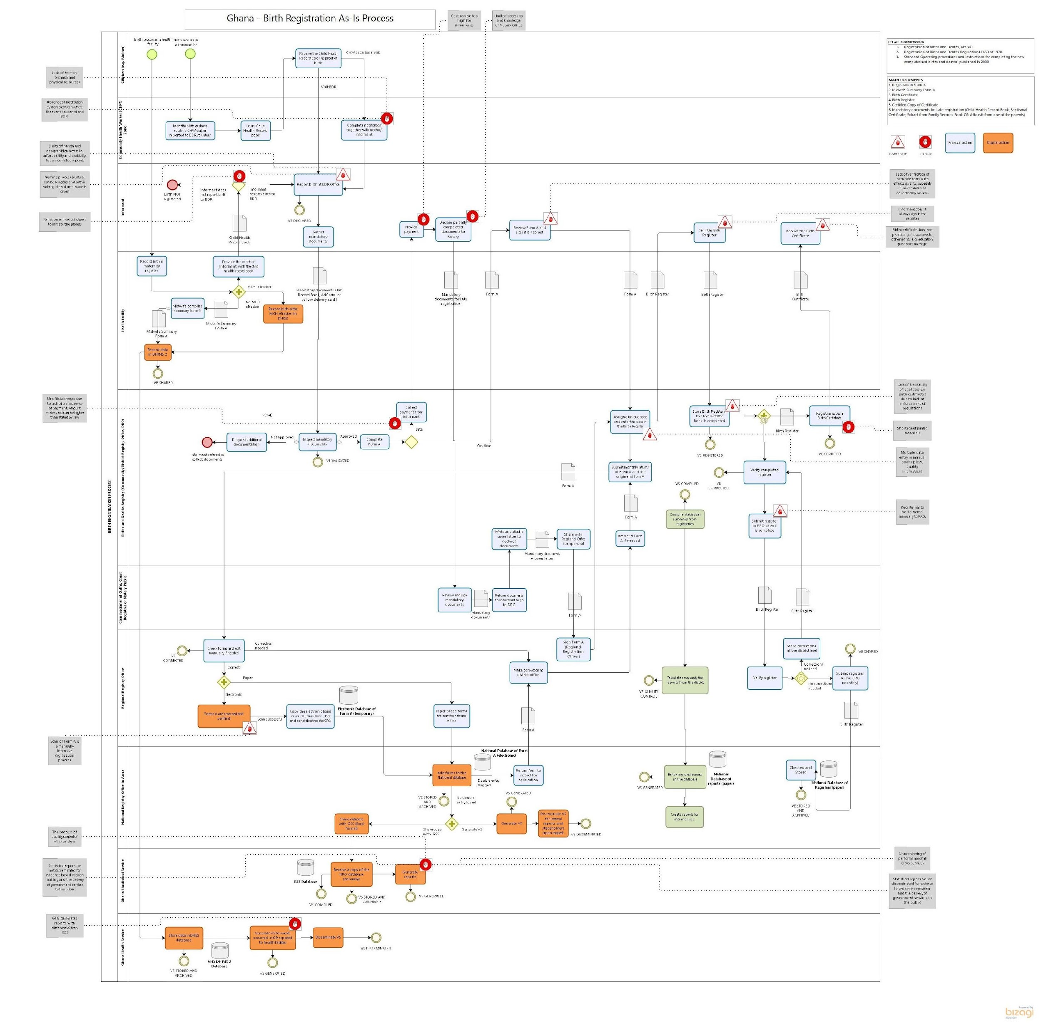
Example | Annotated Birth Registration Process
Notes:
Facilitation notes:
Explain that this is an example of a Business Process Map that has been used to identify areas within the process that could be improved/re-engineered
Explain that there are more examples available in the toolbox of the CRVS-DGB website. Show the other examples.

Slide 59
Activity: Discussion on existing bottlenecks and barriers
What bottlenecks exist in your country?
What barriers exist in your country?
Notes:
Facilitation notes

Slide 60
OpenCRVS Demonstration
Notes:
Facilitation Notes: This is dependent on the facilitators and how much they know about OpenCRVS. This can be replaced with another flash topic.

Slide 61
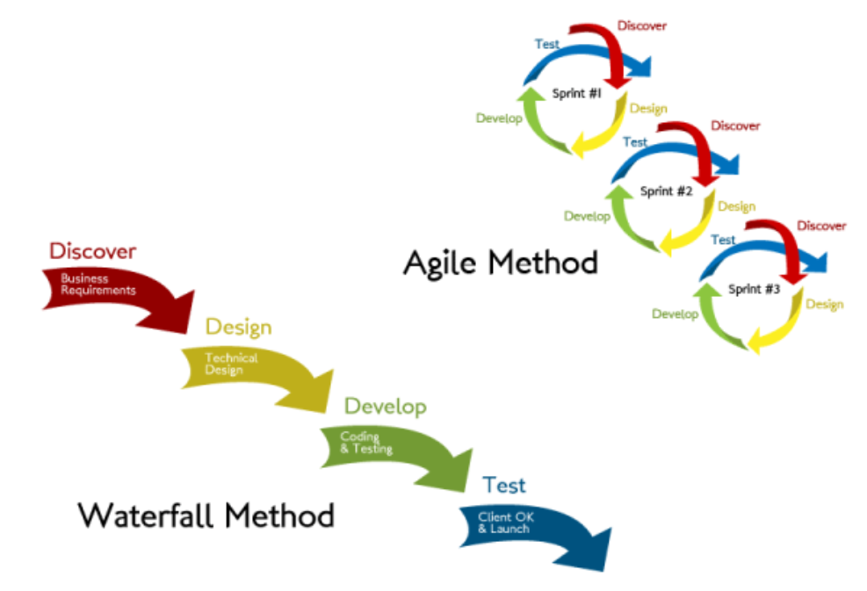
Agile vs Waterfall
Notes:
Facilitation notes:
Waterfall method is the traditional way of developing software
Pros - structured
Cons - very long timelines to delivery, biggest danger is that customer does not get what they really need, lots of room for misinterpretation, need for re-work, can incur high costs, customer often does not know what they need upfront
Agile is a newer methodology that tries to address some of the shortcomings of the waterfall method
Pros - shorter timelines to get a piece of functioning software, allows you to identify problems areas much sooner, save costs and frustration
Cons - need to have immediate access to “product owner” for timely feedback, need to manage expectations carefully and communicate very well
In practice, the software development process is a blend of the two methodologies, with an initial phase of scoping and requirements definition upfront then this evolves into a more agile process

Slide 62
Identify CRVS Digitisation Opportunities & Limitations
Notes:
Facilitation notes:
In order to identify appropriate CRVS technologies that are feasible in the current context, it is important to understand what opportunities and limitations exist in-country to support a digital CRVS system. These opportunities will later be used to inform the definition of the target digital CRVS system and processes.

Slide 63
Identify CRVS Digitisation Opportunities & Limitations
In order to identify appropriate CRVS technologies that are feasible in the current context, it is important to understand what opportunities and limitations exist in-country to support a digital CRVS system.
In country groups, discuss: How would you go about assessing opportunities and limitations for a digital CRVS system in the following five areas?
Current physical and technical infrastructure
Current human capacity to build, maintain and use digital CRVS systems
Existing initiatives that might inform the design of the digitised CRVS system
System integration opportunities
Legal changes are required to support a digitised CRVS system
Notes:
Facilitation notes:
Introduce topic as per slide and facilitate a discussion on how to assess digitisation opportunities.

Slide 64
Exercise: CRVS Digitisation Opportunities
GHANA CASE STUDY
Name | Overview | Organisation(s) | Key Features | Opportunity
Community Population Registration Programme (CPRP) Pilot | 300 registration sites. 91 districts. 300-700 households per community. 2 volunteers per community. | BDR | Focus on on-time community registration Household paper records recorded and updated by volunteer Form A and B filled out by volunteer, and collected by mobile BDR every 2 weeks | Provide common civil registration functionality to other vital events (late birth, death, marriage and divorce) Automate the registration book
mBirth Pilot | 133 districts and 94,000 registrations since end-Aug 2016. | UNICEF TiGO BDR | On time birth registration through online/offline Android app on tablets/mobiles | Provide common civil registration functionality to other vital events (late birth, death, marriage and divorce)
eTracker | GHS are piloting the use of the tracker module in DHIS2 (branded as eTracker for the Ghanaian context) for the capture of patient-level clinical data. | GHS | Patient level clinical data | Additional sources of birth and death notifications.
Notes:
Facilitation notes:
Description: when digitising your CRVS systems, you need not start from scratch. What existing solutions (either forCRVS or otherwise) exist that could be further developed and improved upon s part of CRVS digitisation work?
Opportunities could be:
An existing pilot which can be expanded or rolled out nationally
A technology solution that gathers data in the field; processes notifications; displays aggregate data etc. that could be used for CRVS / fulfils the use cases for CRVS
A particular behaviour among the target population e.g. high completion rates of antenatal care visits etc.
Activity (20 mins in groups + 5 mins to present)
In country groups ask participants to consider what existing initiatives exist that can be further used in CRVS digitisation. Prompt the following areas:
Existing CRVS solutions or pilots exist that could be scaled?
Existing health systems that gather data that could be integrated with CRVS systems?
Community based models that work for CR or other purposes, that might be useful for CRVS purposes?
Effective campaigns that could be extended for BR?

Slide 65
Technical Capabilities
An example from Uganda
Infrastructure | Overview | Opportunity | Limitations
Internet Connectivity | Internet Penetration: 45.8 per 100 population, increase of 3% from Q2 to Q3 (2016) Internet users: Increased by 7.9% from Q2 to Q3 2016 Tele-density (number of telephone connections living within an area): 61.1 for every 100 individuals
Mobile phone access | 52.3% (2014)
Mobile Money | 762 registered mobile money accounts per 1,000 adults (2014)
Notes:
Instructions for facilitator:
Description: when considering CRVS digitisation, you must also consider what existing technical capabilities exist in country. This will prevent you from planning overly ambitious work that can not be supported or maintained by local resources. It also mitigates against risks associated with Technical capabilities are factors in the current context which are particularly useful for a CRVS digitisation project to consider e.g. internet connectivity. If the technical capabilities are low in a country or particular area of the country they need to be improved before CRVS digitisation can be successfully implemented. This exercise is conducted in groups by country to enable each group to understand which opportunities already exist in their countries and which can be explored upon return after this training. Present the table and discuss the importance to consider these contexts with the group. What do these numbers tell us? Does it impact the CRVS Digitisation? If so, how?

Slide 66
Innovation
A new approach
It is about doing things differently
To solve problems
It should respond to an identified need
That makes an impact
It must positively affect society
Originality
Utility
Notes:
Facilitation notes:
What is innovation and why is it required when thinking about CRVS digitisation?

Slide 67
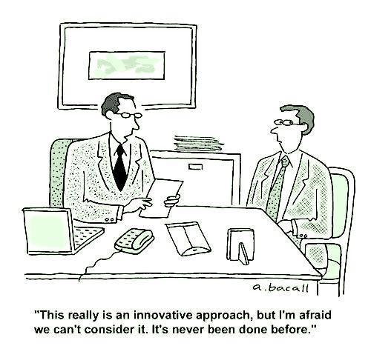
Challenging Orthodoxies
Notes:
Facilitation notes:
Orthodoxy: “it’s always been done that way”. We need to challenge these longstanding “truths” and recognise that we need to do things differently if we are to challenge the status quo.
Just because it’s not been done before, doesn’t mean it’s not worth doing!

Slide 68
Challenge 1:
Costs to both customer and service providers for certificates
Location: Colima, Mexico
Challenge 2:
Regular stock-outs of inventory for birth registration e.g. forms
Location: Cambodia
Challenge 3:
Authenticity of birth registration & certification
Location: Burkina Faso
iCivil
Bracelet with prooftag is provided to baby. The tag contains a QR code that register the details in a central server
“One Stop Shop” for printing of certified copies of 30 types of government registration
Interactive Inventory Management System
Use Interactive Voice Response to report stock levels on a monthly basis
Notes:
Facilitation Notes
Challenge 1:
In 2001, self-service kiosks (cajeros) began to be used in Colima, Mexico to generate certified copies of 30 different types of registrations, including birth and death etc. The initiative was so successful that 100% of certified copies are produced in these “one-stop” shops, reducing the demand on Registrar offices.
2. Challenge 2:
Lack of central digital CRVS system.
Solve a smaller but key problem of supply shortages that were preventing service delivery.
UNICEF and General Dept. of Identification have launched an Interactive Voice Response platform, enabled by RapidPro techonology, which allows direct reporting of stock levels from the commune to central level with information being shared with relevant districts and provinces.
The Commune clerks receive monthly calls on their mobile phones to report on their stock, these reports are then analysed and when stocks fall below a certain threshold an automatic notification is sent to the district officers in charge of re-supplying forms and books.
Provincial staff can monitor performance and plan accordingly.
3. Challenge 3:
A bracelet with a Prooftag Bubble Seal™ is provided to the baby immediately after birth.
The iCivil Android application is then used to scan the seal which contains a QR code, a 2-D barcode that can store digital information, and a serial number. This action prompts the opening of a birth registration form in the application and allows the midwife to capture vital event information. Once completed, a coded SMS is sent to the central server.
When a parent wants to collect their birth certificate they must present the bracelet with Bubble Seal, the seal is scanned and the certificate (with Bubble Seal) can be printed.
Any government body can verify the authenticity of birth certificates and any other identity documents that use the Prooftag technology, online.
Activity:
Ask participants what they think about each of these innovations.

Slide 69
Exercise: Design Thinking Innovation Session
Notes:
Facilitation Notes:
Einstein: 55 mins defining the problem - 5 mins creating a solution
1. Considering the bottlenecks and barriers you identified in the bottlenecks and barriers session, revisit these and prioritise the top 3 challenges
What is the problem?
Why should this be the problem to be resolved?
Present to the group the most pressing problem in a 1 minute elevator pitch.
2. Group vote for the best pitch
3. Problem tree analysis: cause and effect
Root causes
Comparative impacts
Present back: everyone to understand everything that has been said - a better understanding of the problem. You all need to fully understand the problem to be able to solve it
4. Facilitator develop a problem statement
5. In response to the problem statement. Individually write down as many What If statements as possible on posit-it notes.
6. Present each back: facilitator groups them into categories on a board.
7. In mixed groups. Decide on a solution that you will take forward.
8. Draft a newspaper article for the front page, for 2 years-time, with a headline on what difference the solution makes (5mins)
ONE WAY FEEDBACK: I like, I wish…
9. Draw your solution. How do you get to the newspaper article?
ONE WAY FEEDBACK: I like, I wish…
10. Refine your solution
ONE WAY FEEDBACK: I like, I wish…
11. FINAL PITCH: 1 minute elevator pitch to decide which solution should be taken forward.

Slide 70
Principles for Digital Development
Notes:
Facilitation notes:
Description:
Intro (2 mins)
Developed by donors to reflect lessons learnt in the area of digital development.
Principles seek to serve as a set of living guidelines that are meant to inform, but not dictate, the design of technology-enabled development programs.
Activity:
Hand out principles to everyone 1-9 until everyone has one. Participants partner with the other person who has the same number.
(10 mins) Ask participants to discuss what they think the principle means and how they have or can apply this to their CRVS digitisation project.
(20 mins) Stand in a circle and throw the ball to someone: they need to tell the group what principle they have, what it means, and how they have or are going to apply it to CRVS digitisation in their country.

Slide 71
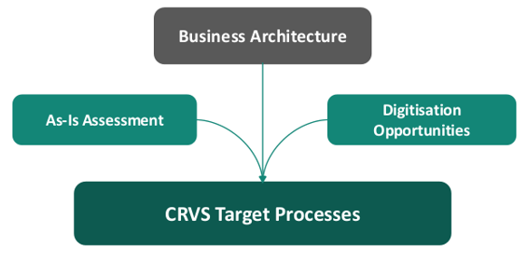
Document the Target CRVS Processes
Notes:
Facilitation notes:
Description:
Target CRVS processes are re-defined processes that respond directly to the weaknesses identified in the As-Is Assessment and the opportunities identified in the previous activity. The target processes should simplify and streamline existing processes i.e. reducing bureaucracy, facilitating the decentralisation of civil registration and improving service provision to citizens. The target processes will be supported by the Target System Architecture which enables simplification and automation

Slide 72
Case Study from Ghana
Ghana CRVS Potential Business Process Enhancements
CRVS Vital Event | Potential Business Process Enhancement | Brief description
Data sources for notification
Birth Death | Health records | Health records from health facilities, community health workers, community health facilities, maternity homes, TBAs, private and public health facilities, can seamlessly be fed into CRVS system. Provides both proof and source of registration data which was previously collected on paper, Form A and B.
Data sources for registration
Birth Death | Mobile Registrar | Liaise with various community groups for collecting information for birth registration, which is entered directly into the system.
Uncompleted registrations
Birth Death | BDR follow up | Uncompleted registrations can be followed up on through a BDR notification queue from which BDR Registrar Manager assigns Mobile Registrars or Volunteers to follow up on through active registration.
Interoperability
Birth Death Marriage Divorce | Single demographic person record | System will link multiple CRVS events to a single person identity.
Notes:
Facilitation Notes: **UPDATE/DELETE BASED ON PARTICIPANTS PRESENT**
10 minutes: Ask the Ghana team to discuss the experience of developing potential business process enhancements for CRVS. Which roles and agencies were involved? Was it useful to have the CRVS processes mapped out in order to discuss and come up with potential enhancements of the existing processes? What kind of enhancements were discussed? Was it easy? Can it be done in a workshop or are multiple meetings required?

Slide 73
Exercise: CRVS Potential Business Process Enhancements
In mixed groups, you have 30 mins to:
Review the previously identified barriers and bottlenecks
Identify potential business process enhancements which could reduce or remove those barriers and bottlenecks
Present the 3 enhancements that you would prioritise and why (5 min per group)
Notes:
Facilitation notes:
Activity:
Split participants into 4 mixed groups
Referring to the bottlenecks and barriers identified in the process analysis activity (on flipcharts), ask participants to conduct steps 1 and 2 above.
**Be sure that participants understand that these need to be process enhancements, and not legislative reform etc. They should consider mapping out the existing problem and then mapping out the potential solution. Visual representation is useful**
After 30 mins, ask each group to present the 3 process enhancements that they would prioritise and why (5 min per group)
Facilitate discussion

Slide 74
Define the CRVS Information Requirements

Slide 75
Define the CRVS Information Requirements
Understand what information requirements exist i.e. what data is collected, stored and put to use within the existing CRVS system.
Understanding what logical entities exist within the CRVS business domain and the relationships between them.
Together with the Data Dictionary, they form the basis of the data architecture which, when detailed at the lowest level, will later define the CRVS database design.
Notes:
Instructions for facilitator:
Before being able to define what systems are required to support the CRVS business need, it is necessary to understand what information requirements exist i.e. what data is collected, stored and put to use within the existing CRVS system. At the highest level this means understanding what logical entities exist within the CRVS business domain and the relationships between them. Together with the Data Dictionary, they form the basis of the data architecture which, when detailed at the lowest level, will later define the CRVS database design.

Slide 76
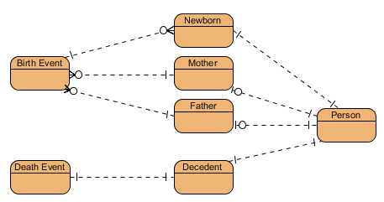
Define the CRVS Information Requirements
ERD - Entity Relationship Diagram
Illustrates an information system’s entities and its relationships.
Notes:
Facilitation notes:

Slide 77
Tool: CRVS-Data-Dictionary-Template
Capturing data fields
Notes:
Facilitation notes:
Navigate to the CRVS-Data-Dictionary-Template
Explain the CRVS Data Dictionary Template. How is it put together? How is it maintained?

Slide 78
Define the CRVS Information Requirements
Questions to consider:
Where will master data be stored?
How will each data entity be used by each CRVS actor and process?
How and where will each data entity be created, stored, transported and reported?
What data transformation is required to support the information exchange between solution components?
What data is needed to calculate vital statistics?
What data do we need to track individuals?
Notes:
Facilitation notes:

Slide 79
Define the CRVS Information Requirements
In country groups:
List the entities that you think should form part of your countries CRVS system
What is the key data that should be stored for each entity
Use the questions on the previous slide to help
Notes:
Facilitation notes:

Slide 80
Interoperability and Integration with other systems
Two key questions:
How systems are arranged so that they may communicate?
What format do systems send and receive data in?
Notes:
Facilitation Notes
Interoperability is “the ability of different information technology systems and software applications to communicate, exchange data, and use the information that has been exchanged.”
We need to understand what data needs to be exchanged between systems, what format is it in and how can we ensure that the data means the same thing in both systems?

Slide 81
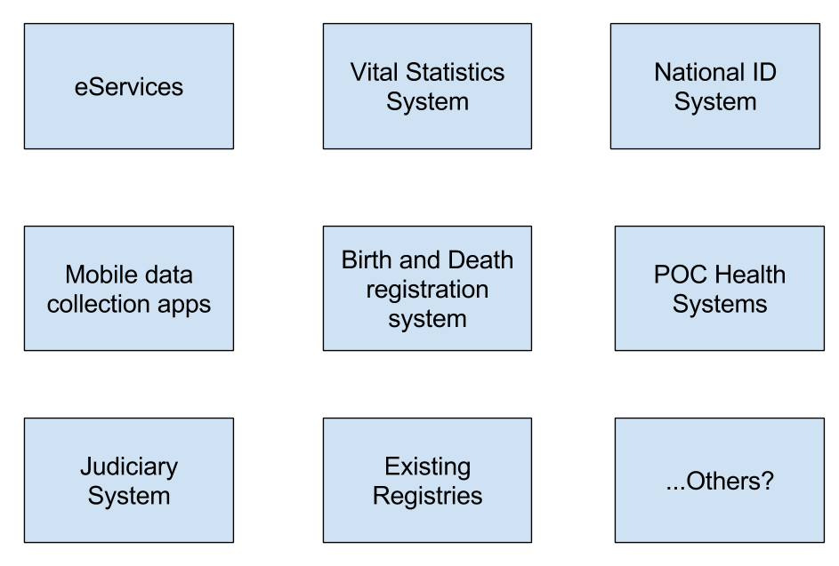
Interoperability and Integration with other systems
List out system involved, e.g.

Slide 82
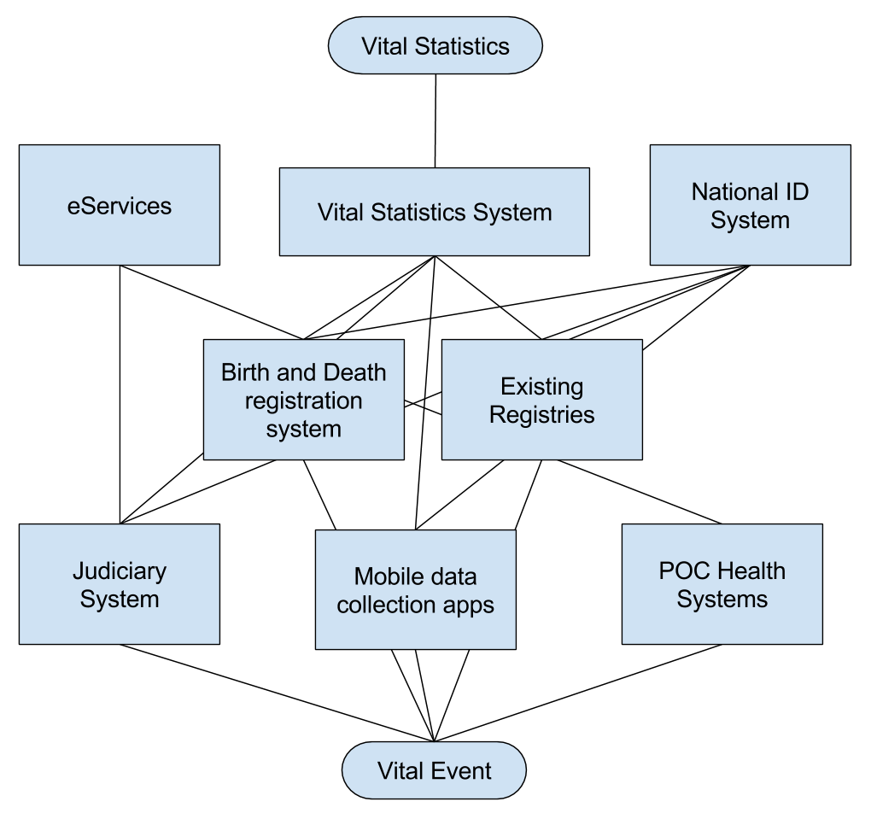
Interoperability and Integration with other systems
Point to point communication, not ideal
Notes:
Facilitation Notes
Highlight issues where there is integration between different systems and complexity of managing this as more and more systems become involved

Slide 83
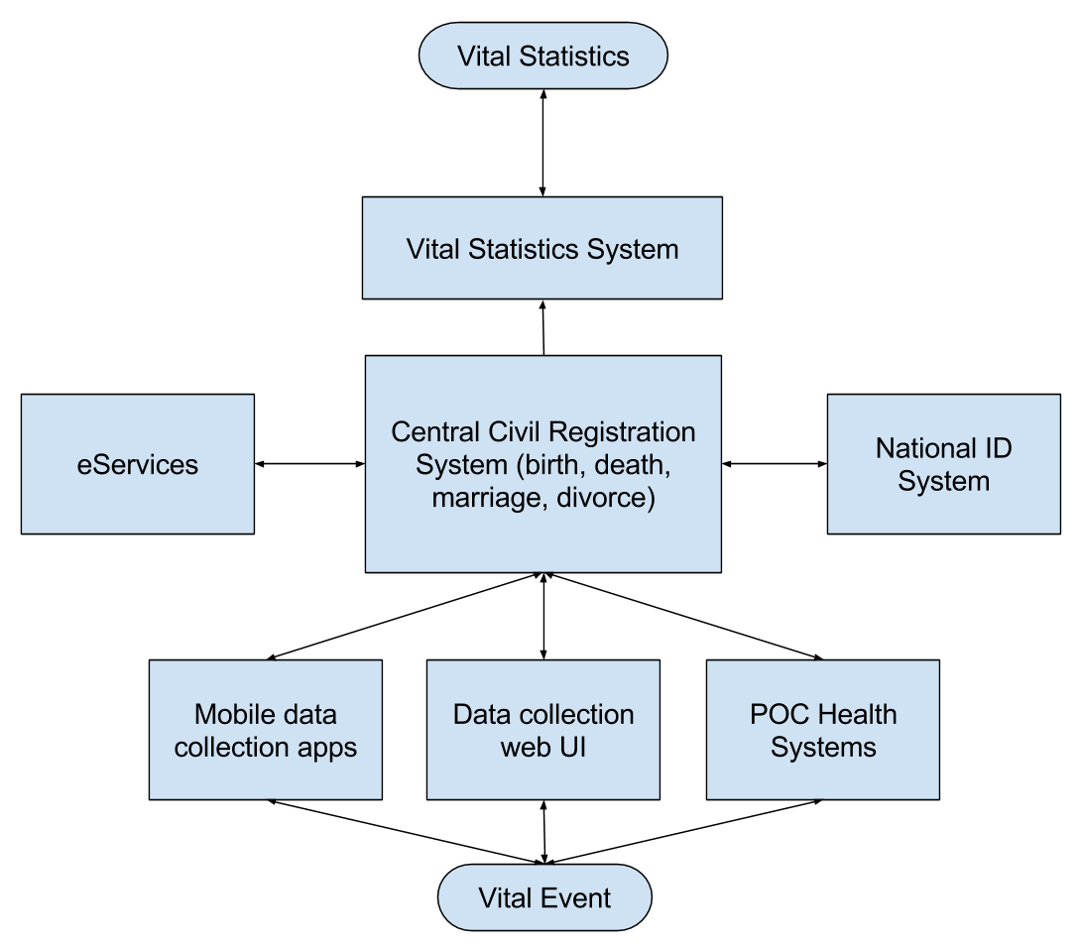
Interoperability and Integration with other systems
Central architecture, more manageable
Notes:
Facilitation Notes
Benefits of interoperable architecture
Explain how this is 1. More manageable, more secure, easier to “rip and replace” components

Slide 84
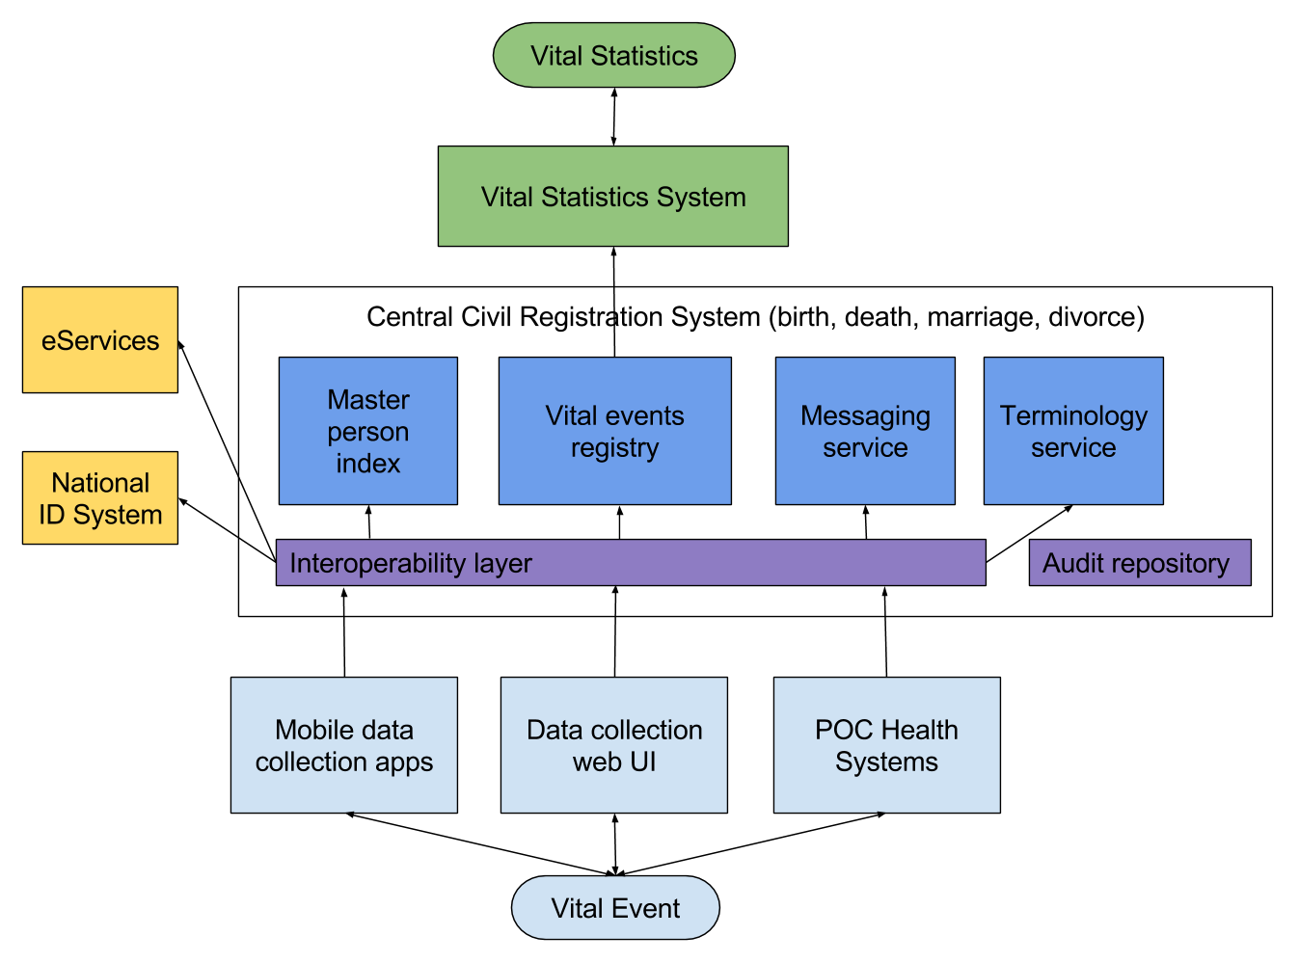
Interoperability and Integration with other systems
CRVS interoperability component architecture

Slide 85
Interoperability and Integration with other systems
Standard data formats:
Provide a specification for how information can be shared
Allow new system to hook into the system more easily
Prevent vendor lockin
Allows system to be replaced over time

Slide 86
Interoperability and Integration with other systems Example of base health care data standards:
Traditional: HL7v2
- Uses custom message exchange format, older style message
Modern: FHIR
- Uses JSON message format, more modern and easier for current devs to understand

Slide 87
Interoperability and Integration with other systems Suggested interoperability architecture:
Central events registry + supporting services
Controlled access and auditing with an interoperability layer
Well defined standards-based messages for data exchange
Components can be replaced over time

Slide 88
Interoperability and Integration with other systems
Thanks!
Q&A

Slide 89
Define Target System Architecture
Holistic model of the applications required to fulfil business needs and support target processes.
A CRVS system does not sit in isolation.
It relies on data inputs from a variety of potential sources and should also provide access to other systems/authorised agencies for different purposes.
Notes:
Instructions for facilitator:
Ask a participant to navigate to this section of the DGB.
Introduce tools and templates that are part of this section.
The target system architecture is a holistic model of the applications required to fulfil business needs and support target processes.

Slide 90
Who uses the CRVS system?
In mixed groups, identify:
Sources of civil registration
Users of central CRVS data
External Systems that might want to interface with the central CRVS system
Communication that the system needs to do e.g. SMS
Digitisation of paper records
Notes:
Facilitation notes:
Activity:
Ask participants to identify all of the users (people and systems) of a CRVS system. They should draw this with a CR system in the middle and each of the areas around the outside.. (this will form a system architecture)
Sources of civil registration: where will civil registration data come from e.g. health systems, registration office at district level, home etc.
Users of central CRVS data e.g. local and national level government, stats office etc.
External Systems e.g. ID, passport etc.

Slide 91
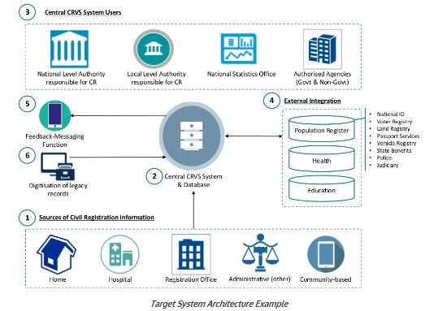
Exercise: Map Target System Architecture
Notes:
Facilitation notes:
This is a conceptual diagram of a system architecture.
Ask participants whether they see similarities to the diagram they just drew
NOTE: All cases below are potential options for consideration only and will depend on the country context.
Multiple sources of Civil Registration Information
Home: Web-based application that allows home users to register vital event online, provide supporting documentation, pay and select a delivery method for the certificate.
Hospital: Web-based/desktop application that allows hospital staff to register vital events (birth and death), transfer data directly to central CRVS system and issue a certificate.
Registration Office: Web-based/desktop application that allows responsible registration agents (from responsible authority) to register vital events, transfer data directly to central CRVS system and issue a certificate.
Administrative (other): Web-based/desktop application that allows judiciary/police to register vital events, transfer data directly to central CRVS system and issue a certificate.
Community Based: Mobile application that allows community registration agents to notify of vital events by gathering civil registration data in the community and submitting to central system for validation and certification.
2. Central CRVS System and DatabaseCentral civil registration and vital statistics system that fulfils all required CRVS functions.
3. Central CRVS System Users
Authority responsible for civil registration (national level): operational monitoring, system and user management, data analysis for planning & development purposes.
Authority responsible for civil registration (local level): Registration, certification, operational monitoring.
National Statistics Office: Vital statistics analysis and dissemination of reports.
Authorised Agencies (government and non-government): Access to vital statistics for planning & development purposes.
4. Integration with external systems/Validation with external data source: When the Central CRVS System receives a vital event notification, it further validates this information against an appropriate external data source e.g. population register, biometric system and auto-populates content in source applications.
Access to civil records for:
Population Register
Health
Education
Other as appropriate
5. Feedback – messaging: As the vital event notification is processed and validated, the informant is sent an SMS message containing details of the processing status.
6. Digitisation of legacy records: Digitisation and transformation of legacy (paper) records and load into central CRVS system and database

Slide 92
Notes:
Facilitation notes:
Provide overview of pros and cons of open source and proprietary software.
Facilitate discussion

Slide 93
Define System Requirements
Notes:
Facilitation notes:
Ask participants what a system requirement is and why it is required (5mins)

Slide 94
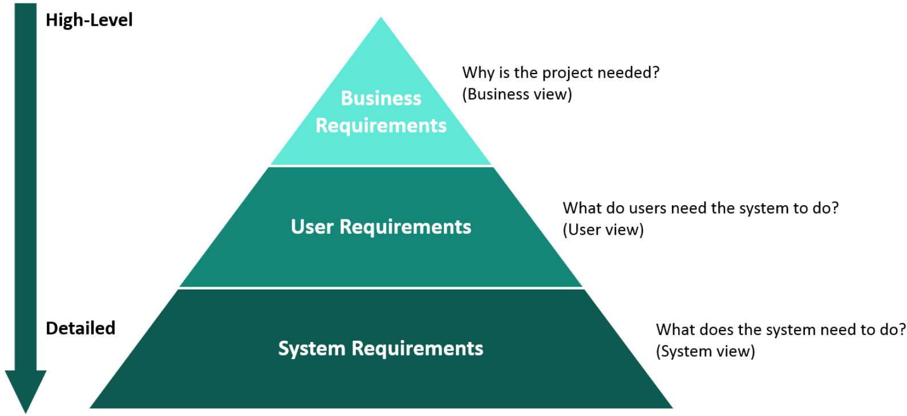
Define System Requirements
Notes:
Instructions for facilitator:
Clearly articulated statements of what a system must be able to do in order to satisfy stakeholder needs and requirements and are derived from business requirements and user requirements, as per the “Requirements Hierarchy” figure below.
They should be defined in two clear categories, functional and non-functional. Functional requirements describe the required behaviour and functions of the system. Non-functional requirements describe specific criteria that can be used to judge the operation of a system e.g. performance, security, availability.

Slide 95
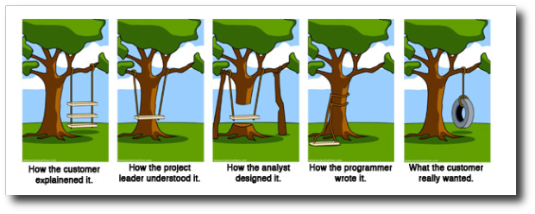
Define System Requirements
Notes:
Facilitation notes:
Allow participants to read the cartoon.
Ask participants what they think the cartoon is saying.
Why are requirements important?
Highlight the importance of defining robust system requirements:
Ensure that all people involved in the development of the system are on the same page about what is being developed.
Quality control – if the system doesn’t do what is required, it is not ready
Users should be at the CENTRE of the requirements gathering process (refer back to principle 1 of the Principles for Digital Development: “Design with the user”)

Slide 96
Exercise: User Personas
Persona Name | What is the name of this person?
Persona Role | What role does this person play within the CRVS system?
About | What are their characteristics e.g. gender, age, education level, computer literacy, motivations, concerns, etc.?
Responsibilities | What is this person responsible for in terms of the CRVS system. What work do they do? What do they need to do it?
Challenges | What challenges does this person face with regards to their CRVS responsibilities. What problems do they face? What frustrations do they have? What limitations do they encounter?
Needs & Wants | What benefits would the user expect from this system?
Environment | Where does this person live/ work? What resources do they have? What limitations are there?
Notes:
Facilitation notes:
Description: A user-centred design approach is a key strategy for building a robust, usable system. Scalable, sustainable systems are designed when development teams understand the viewpoint and experience of the users. User Personas are fictional characters created to represent the different user types, the challenges they face and their desires for potential solutions. System design teams are better equipped to make empathetic design decisions for their solutions that are based off of the users’ needs, motivations, and challenges.
Activity:
Split participants into mixed groups.
Based on the users identified during the system architecture exercise, select one user that you want to think about in this system requirements section.
Ask each group to announce which user they will work with.
Ask each group to create a user persona, using the above template. Feel free to put a face to a name!
Ask each group to present their persona to the group.

Slide 97
Exercise: User Journey
In the same groups:
Write a user journey based on the user persona you just developed, and what the user wants to achieve by using the system.
Create a visual representation of the journey.
Present your user journey.
Notes:
Facilitation notes:
Ask participants what a user journey is, or what they think it is.
Provide an explanation of what a user journey is and how it can be used in the development of system requirements.
A user journey is a series of steps) which represent a scenario in which a user might interact with the thing you are designing. They help in Demonstrating the vision for the project , They help us understand user behavior , They help identify possible functionality at a high level ,
User journeys typically come towards the beginning of a project in the discovery or requirements gathering phase, normally after personas. This is both to visualise the user requirements and help feed into other design activities such as information architecture or wireframing. However, they can also be used further down the line when scoping out pieces of functionality in more detail.
Provide the OpenCRVS user journey and ask them to read it through.

Slide 98
Exercise: Requirements Definition
As a X, I want to do Y so that I can Z.
As a registration agent I want to be able to select from a drop down list of types of death, so that I can save time.
As a national manager for civil registration, I want to be able to see aggregated performance data, so that I can provide targeted support to low-performing offices.
As a health worker, I want to be able to submit birth notification details once so that I do not have to repeat this activity.
Notes:
Facilitation notes:
One way to start writing system requirements is to structure them like this: As a X, I want to do Y so that I can Z.
The benefit of this approach is that each requirement calls out 1. WHO the user is, 2. WHAT they want/need, and 3. WHY this is required.
Talk through the samples included on the slide.
Confirm that everyone understands this approach – ask a couple of participants to confirm by giving an example.
Activity:
Based on the user journey that you have developed (depending on quality use OpenCRVS one if necessary), we will now begin to develop system requirements for this journey.
Working in mixed groups, create a list of these requirements statements for your user journey.
Present back 5 of the requirements and discuss each one with the group.

Slide 99
SMART Requirements
S.M.A.R.T
The report should display all the monthly data from the marketing department
The monthly registration report shall contain the following columns: Location of registration office; total number of births registered; total number of deaths registered;
Notes:
Facilitation notes:
The next step is to translate the statements defined in the previous activity into SMART requirements.
Ask participants what SMART stands for.
Specific – target a specific area for improvement.
Measurable – quantify or at least suggest an indicator of progress.
Attainable – it can actually be achieved.
Relevant – does it contribute to the purpose of the solution/add value.
Time-related – specify when the result(s) can be achieved.
Ask participants which of the requirements included on the slide is SMART and why. Discuss

Slide 100
Tool: CRVS-System-Requirements-Template
Notes:
Facilitation notes:
Show participants the template available

Slide 101
COMMUNITY-BASED VERBAL AUTOPSY IN GHANA: LESSONS FROM FIELD TEST
Notes:
Facilitation Notes: **INSERT FLASH TOPIC AS APPROPRIATE FOR PARTICIPANTS**

Slide 102
CONSIDERATIONS REQUIRED WHEN CONSIDERING DEATH REGISTRATION AND VERBAL AUTOPSY
Ghana’s Death Registration Scenario
Distribution of deaths;
Health facility based (≈ 30%) versus community based (≈ 70%)
Low level of death registration (very low at ≈ 20%)
The role of different agencies/institutions in the death registration process
Family-led notification
Involvement of local authority structures
Health system – issuance of MCCOD
Absence of a clear notification step in the business process
Notes:
Facilitation Notes: **INSERT FLASH TOPIC AS APPROPRIATE FOR PARTICIPANTS**

Slide 103
POTENTIAL SOLUTIONS FOR DEATH REGISTRATION AND VA - 1
Developed Clear notification system – could be;
Paper based (e.g. VA field test in Ghana)
E-notification
Direct notification (e.g. from the health system to the CR system)
Data/Information sharing or exchange between various agencies. Some things to consider;
Who sends what information to who?
How is this information exchanged?
How is the information collected?
How is the information received?
Notes:
Facilitation Notes: **INSERT FLASH TOPIC AS APPROPRIATE FOR PARTICIPANTS**

Slide 104
GHANA’S EXAMPLE WITH VA - 1
Death Notification System for Community-based Deaths
A paper notification form is filled at the local authority in triplicate;
One form goes to the family for follow-up and registration at the CR authority
Second form goes to the community health worker to trigger VA
Third copy is retained at the local authority
Considerations for potential solutions
Can notification be done through an electronic system?
Who fills the electronic notification? Is this person literate?
Is this person abreast with technology?
How will the information be transmitted?
Can the information be linked to other vital information?
Notes:
Facilitation Notes: **INSERT FLASH TOPIC AS APPROPRIATE FOR PARTICIPANTS**

Slide 105
GHANA’S EXAMPLE WITH VA - 2
Data collection
Interviewers are trained community health workers
Data is collected using tablets
Data is sent directly to a central server
System managed by professional health information officers
Analysis of data to determine probable cause of death using computer algorithms
Considerations for potential solutions
How will data be collected?
What cadre of interviewers will used be used to collect data?
How will data be transmitted?
Will COD be system generated or physician coded?
How can COD be linked with death registration and individual death records?
Notes:
Facilitation Notes: **INSERT FLASH TOPIC AS APPROPRIATE FOR PARTICIPANTS**

Slide 106
Module 4 Implementation Planning

Slide 107
Preparation
Analysis and Design
Implementation Planning
Define a Long-Term Vision for CRVS Digitisation
Initiate CRVS Digitisation project
Document CRVS Digitisation Implementation Plan
Develop a Business Case for CRVS Digitisation
Define the CRVS Business Architecture
Procure the Digital CRVS System
Conduct As-Is Assessment of the CRVS Landscape
Define the Change Management Approach and Plan
Identify CRVS Digitisation Opportunities and Limitations
Define the Deployment Approach and Plan
Document the Target CRVS Processes
Define the Training Approach and Plan
Define the CRVS Information Requirements
Define the Testing Approach and Plan
Define Target System Architecture
Define Operations Approach and Plan
Define System Requirements
Notes:
Facilitation notes:
Ask a participant to navigate to the implementation planning section of the DGB.
Introduce each section of the implementation planning section.

Slide 108
Document CRVS Digitisation Implementation Plan
Take time to plan the next phase of activities, from system procurement through to the beginning of full system deployment.
Mitigates the risk of schedule and cost overruns.
Provides a structured framework for ongoing project monitoring and reporting.
Should be done within the context of the wider CRVS strategic plan to ensure that the project is not operating in isolation.
Notes:
Instructions for facilitator:
On completion of all activities in the Analysis and Design phase, it is important to take time to plan the next phase of activities, from system procurement through to the beginning of full system deployment. Conducting a comprehensive planning exercise mitigates the risk of schedule and cost overruns and a well-defined implementation plan provides a structured framework for ongoing project monitoring and reporting. This should be done within the context of the wider CRVS strategic plan to ensure that the project is not operating in isolation and any interdependencies are clearly acknowledged by all parties. The shift from analysis and design to implementation will also require you to revisit the PID and adjust the project team and governance to support the changing nature of the activities. You will also need to update the CRVS Business Case template to complete the costing sections related to Systems Development, Testing and Implementation.

Slide 109
Exercise: What should be included in an implementation plan?
In country groups, discuss for 15 mins:
What are the key components
What are the key milestones
What are the key dependencies
…that should be included in an implementation plan.
Present back to the group (5 min per group)
**HINT** check out the guidebook...
Notes:
Facilitation Notes:
Activity:
Ask participants to work in country groups and to consider the 3 points included in the slide.
“components” refer to different areas of a CRVS Digitisation plan e.g. not just technology. How do you ensure that this technology is effectively implemented (legal and policy, change management, training, pilot etc.)
“key milestones” refer to the occurrence of events that have a major impact on the project e.g. change in legislation that removes the need for paper records, go-decision etc.
“key dependencies” refer to the activities that rely on another activity to take place e.g. infrastructure needs to be in place to deploy technology solution.
The scope of this plan should include implementation planning activities; procurement*; prototype development; design, build and test of the system. pilot deployment*; scale-up*; training*, change management* and operations*

Slide 110
Discussion: Procurement Experiences
Have you procured a CRVS system (or part of one)?
What was your experience?
What process did the vendor go through to gather requirements?
Did the vendor conduct any of the analysis similar to the CRVS DGB?
Is the system fit for purpose?
What challenges have you faced, if any?
What advice would you give others about to procure a system?
What advice do you wish you had had / need when procuring a CRVS system?
Notes:
Facilitation Notes:
This exercise will only be successful if people in the room are willing to share their procurement experiences. It would be useful to share a procurement experience that you have / “classic” procurement case that highlights common experiences such as vendor lock-in, not getting what is required etc.
Activity:
In mixed groups, discuss the questions included on the slide
Come back together as a full group and discuss key take-aways.

Slide 111
Contract Top Tips
Define clear list of deliverables and scope of work.
Link the delivery schedule with gated reviews to ensure that each step of implementation is reviewed before progressing to the next stage.
Link payment to delivery milestones.
Review your implementation plan with the awarded party and update it to reflect developer inputs.
Define clear statement on the terms of warranty
Include clause on Intellectual property and ownership of software.
Notes:
Facilitation Notes:
Talk through and discuss the contract top-tips
Are there any additional ones from participants?

Slide 112
Integrated approach to CRVS digitisation
Process & technology: making birth registration services effective and accessible
Change Management: building the capacity and engagement of individuals across all levels of administration to provide effective & efficient birth registration services
Monitoring & Evaluation: Proving a model that is scalable & sustainable through rigorous M&E and continuous improvement
Advocacy: advocating for a supportive and rights based legal and policy framework
Behavioural Impact: creating demand for birth registration through an integrated marketing and communications campaign
Notes:
Facilitation notes:
Technology alone is not enough to bring about a lasting improvement of CRVS. You need to take an integrated approach to your programme:
Why is this important?
What should you consider?
Explain each component of the integrated birth registration model as developed by Plan International. This approach goes for the whole of CRVS.

Slide 113
Exercise: Implementation Challenges
In mixed groups, discuss:
What does your
What are the key challenges in your area of implementation?
How will you address these challenges?
Present back to the group (5 min per group)
Notes:
Facilitation Notes:
Purpose: allow participants to consider the different challenges in each of the implementation areas identified in the guidebook.
Activity:
Split participants into mixed groups, with enough groups to cover: training, change management, testing, operations.
Get each group to answer the questions included on the slide.
After presentation facilitate a discussion to ensure that common challenges and solutions can be discussed.

Slide 114
for CRVS Digitisation
Notes:
Facilitation Notes:
Discussion:
Ask participants again about why a business case is required for CRVS digitisation, and what should feature in a business case (text below is as per day one).
CRVS is often not prioritised.
A Business Case will help:
Explain how technology can be a cost-effective means to improve CRVS systems and processes.
Should be used to:
Indicate the expected benefits of CRVS digitisation
Get buy-in from key stakeholders
Justify the technology investment costs
Raise funds for project implementation

Slide 115
Exercise: Make the Case!
In country groups:
What would be the value of universal civil registration to stakeholders in your country?
Present the case to the Ministry of Finance (Facilitation Team) and they will decide if you get the money…
Notes:
Facilitation notes:
Review the items gathered on the “Business Case” poster throughout the week.
In country teams :what would be the value of universal civil registration for the National Identification Office?
A response could be: that everyone could have a national identification number from birth.
Make sure the group comes up with ideas for all the categories included in the business case template. Ask questions to give them ideas if no new ideas are coming. Make sure the group understands that the benefit of this exercise is to have a list of added value or benefits to present to for example the Ministry of Finance of why investment in CRVS Digitisation is so important.

Slide 116
Deliverables
Deliverable 1: Long-term CRVS Digitisation Vision
Deliverable 2: Draft CRVS System Architecture to support long-term CRVS Digitisation Vision.
See the CRVS DGB for examples of these deliverables
Due 1 MONTH after completing this training: Friday 29th September
Notes:
Facilitation Notes: **UPDATE BASED ON WHERE PARTICIPANT COUNTRIES ARE AT AND WHAT IS RELEVANT**

Slide 117
World Bank Training
CRVS training developed by the World Bank in partnership with partners from all sectors
13 modules that familiarise you with all key areas of knowledge if you are working in the area of CRVS
Module 10: CRVS Digitisation – developed based on the CRVS Digitisation Guidebook.
https://olc.worldbank.org/content/civil-registration-and-vital-statistics-systems-basic-level-self-paced-format
Notes:
Facilitation notes:
Show participants the online CRVS training available through the World Bank and encourage them to complete the full course.
Highlight the CRVS digitisation module, developed based on the CRVS DGB.

Slide 118
Thank you

